Slide 1
Queueing Theory A Mathematically Rigorous yet Intuitive Guide
By
Rishabh Pomaje
&
Samyak Sanjay Parakh

Slide 2
Motivation & Background
Queue
Queueing Theory
‘Study of Waiting’.
Why do queues form?
Finite Resources
Finite efficiency
Why to study queues?
Resource Planning
Decision Making
What’s there to study?
Randomness in Arrival times
Randomness in Demands.
Server
Arrivals | Server | Resource
People | Doctor Bank Manager | Doctor’s time Manager’s time
Planes | Air Traffic Controller | Runways at an airport.
System Processes (Tasks) | Microprocessor Or Microcontroller | Memory + Compute resources (Cores)
Examples of Queues

Slide 3
Basic Assumptions
Whenever a server is free, and there is a customer in the queue, the customer immediately goes into service.
Whenever a server is busy if a customer arrives, the customer waits in the queue*.
Whenever a server becomes free, the next customer is decided according to a scheduling policy/ discipline.
Customers do not become impatient and leave the queue before their service completion.

Slide 4
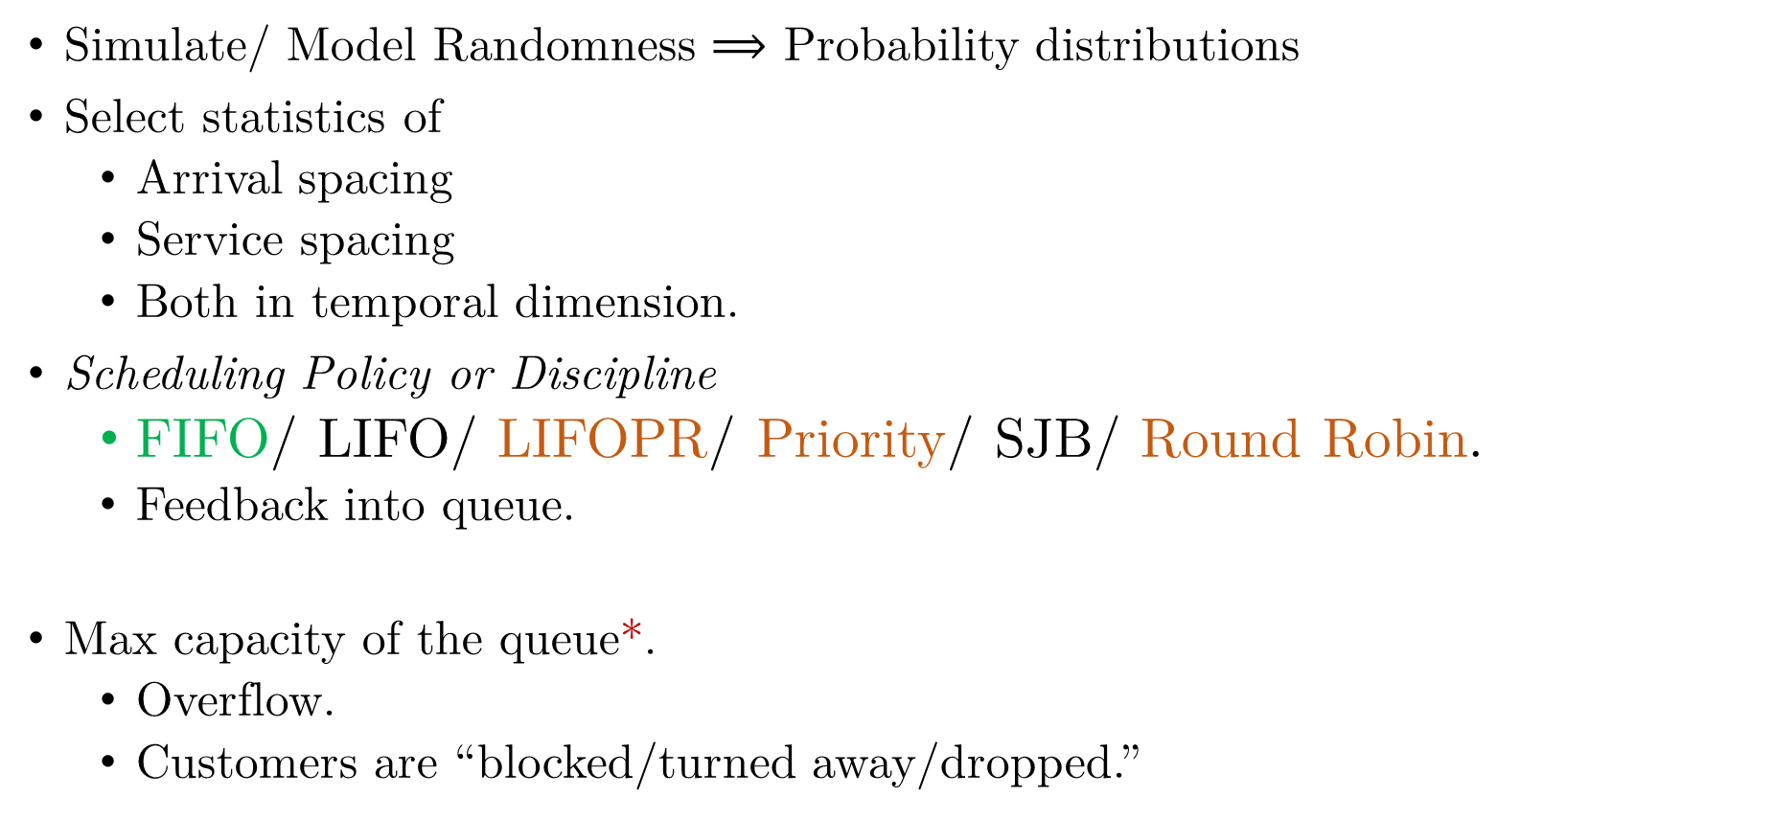
Modeling Queues
Simulate/ Model Randomness $⟹$ Probability distributions
Select statistics of
Arrival spacing
Service spacing
Both in temporal dimension.
Scheduling Policy or Discipline
FIFO/ LIFO/ LIFOPR/ Priority/ SJB/ Round Robin.
Feedback into queue.
Max capacity of the queue*.
Overflow.
Customers are “blocked/turned away/dropped.”

Slide 5
Notation
Kendall Notation
A / B / C / X / Y / Z
A = Inter-arrival time distribution
B = Service time distribution
C = Number of servers
X = System Capacity
Y = Size of the customer population
Z = Queue scheduling discipline

Slide 6
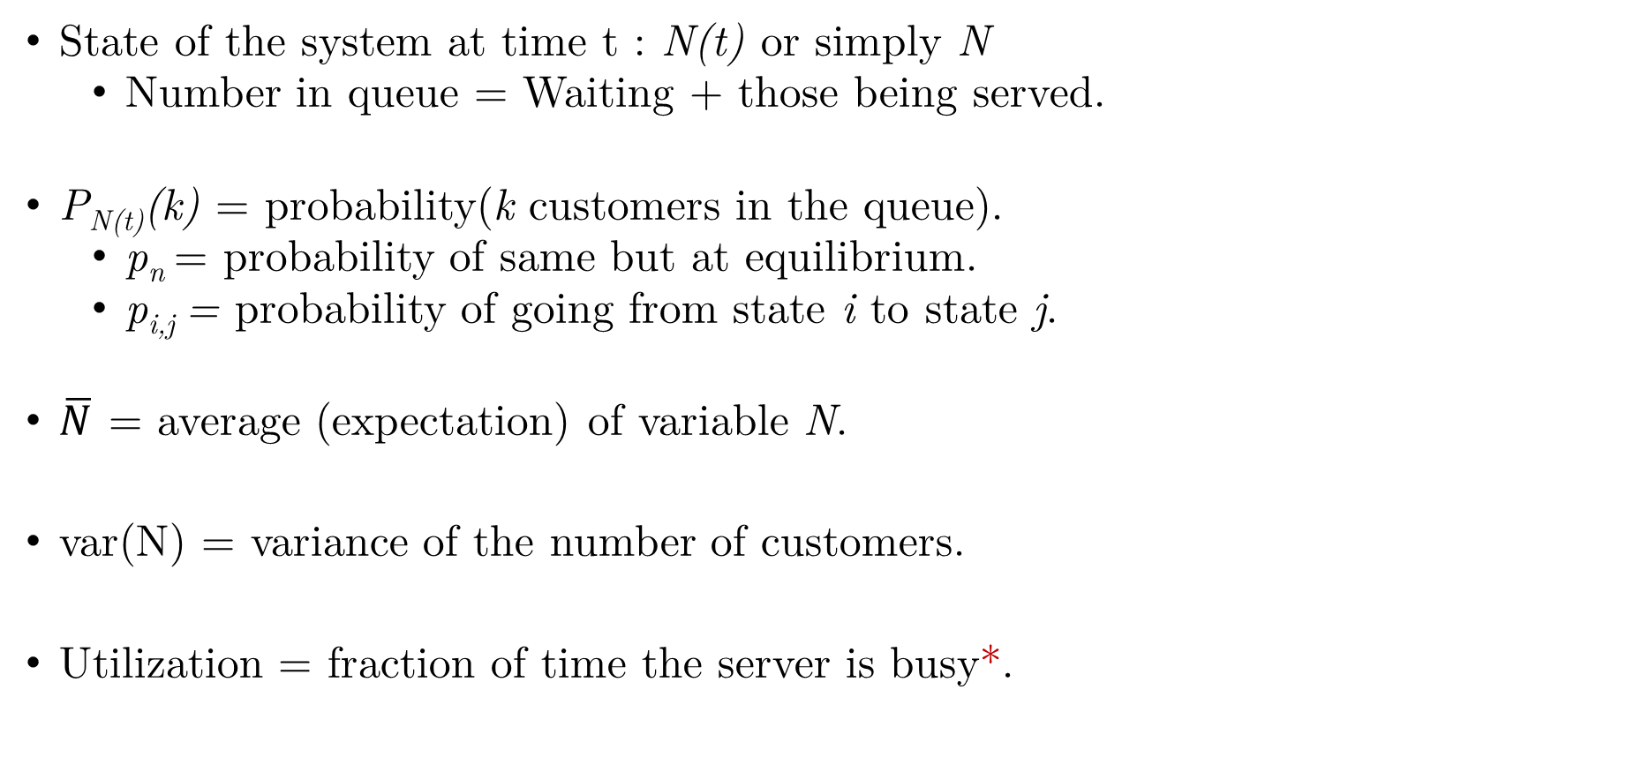
Notation
State of the system at time t : N(t) or simply N
Number in queue = Waiting + those being served.
P_{N(t)}(k) = probability(k customers in the queue).
p_{n} = probability of same but at equilibrium.
p_{i,j} = probability of going from state i to state j.
$\overline{N}$ = average (expectation) of variable N.
var(N) = variance of the number of customers.
Utilization = fraction of time the server is busy*.

Slide 7
Objectives
Preliminary analysis
First-order analysis.
We will be looking at steady-state analysis.
The system is in equilibrium.
The state distributions, i.e., prob(system is in some state i), become time-invariant.
For each of the cases, we have some measures/metrics of performance that depend on the state probabilities or state distribution.

Slide 8
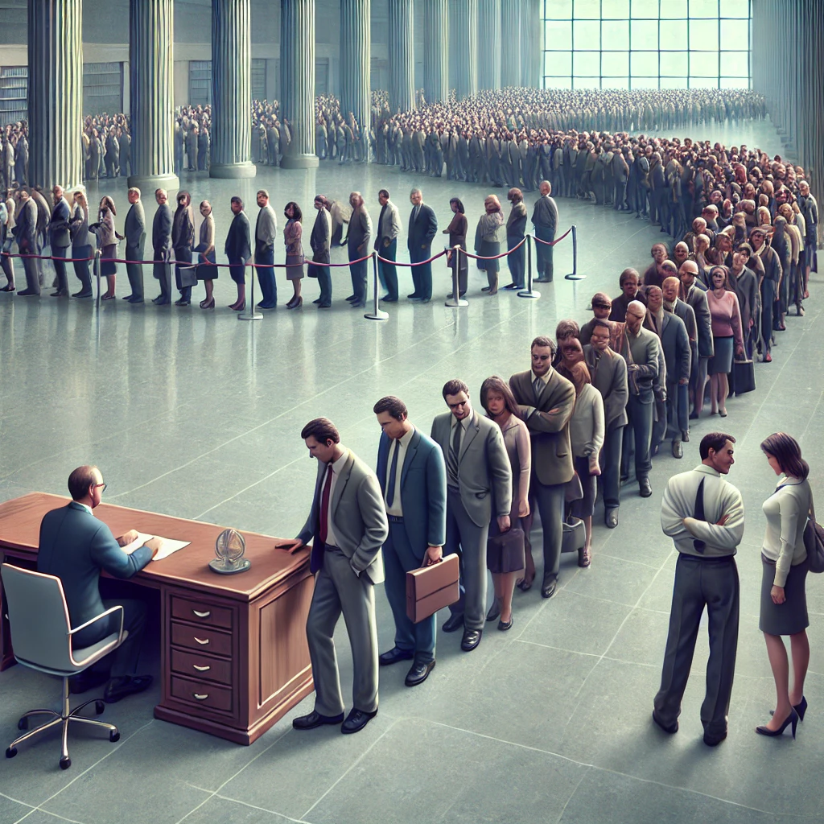
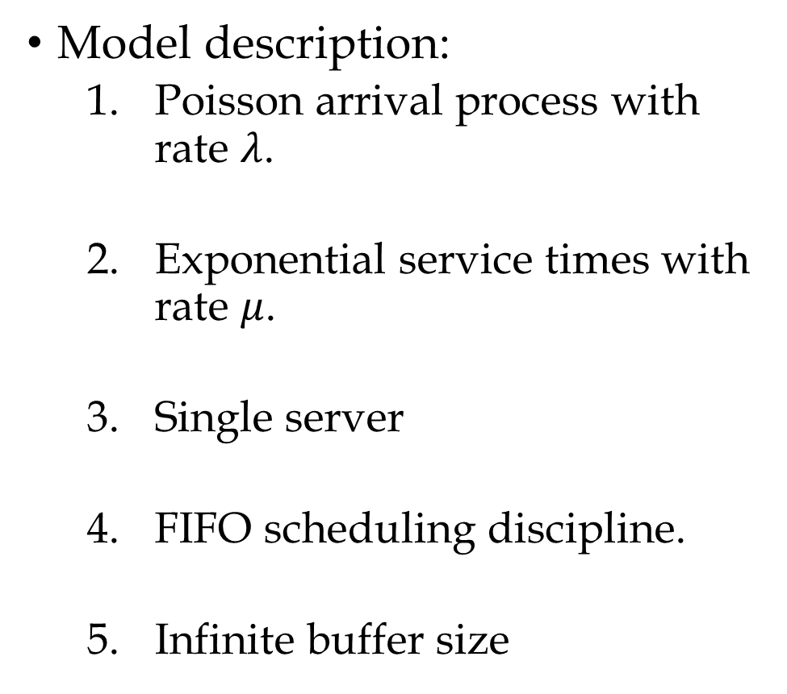
M / M / 1 Queue – a recap
Model description:
Poisson arrival process with rate $λ$.
Exponential service times with rate $μ$.
Single server
FIFO scheduling discipline.
Infinite buffer size
Source: DALL·E

Slide 9
Overview of Derivation

Slide 10
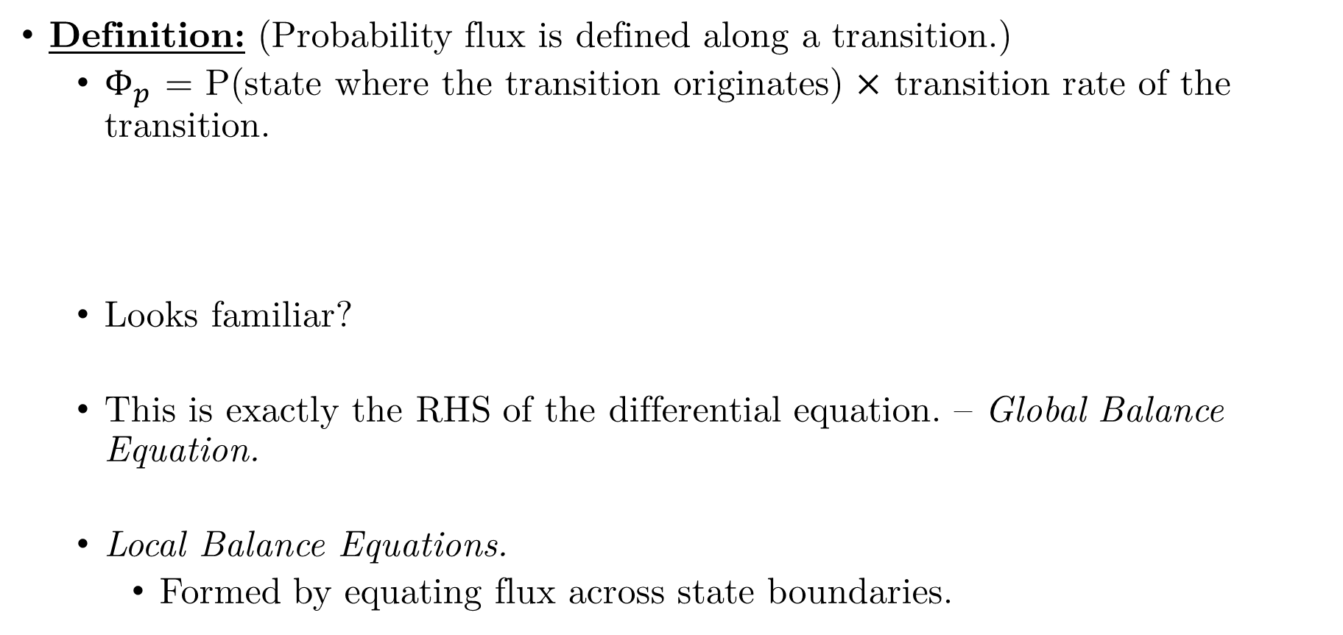
Digression – Probability Flux
Definition: (Probability flux is defined along a transition.)
$Φ_{p}$ = P(state where the transition originates) $×$ transition rate of the transition.
Looks familiar?
This is exactly the RHS of the differential equation. – Global Balance Equation.
Local Balance Equations.
Formed by equating flux across state boundaries.

Slide 11
Solution
Local Balance equations:
Combining all of them we get the following solution:

Slide 12
M / M / 1 - Summary

Slide 13
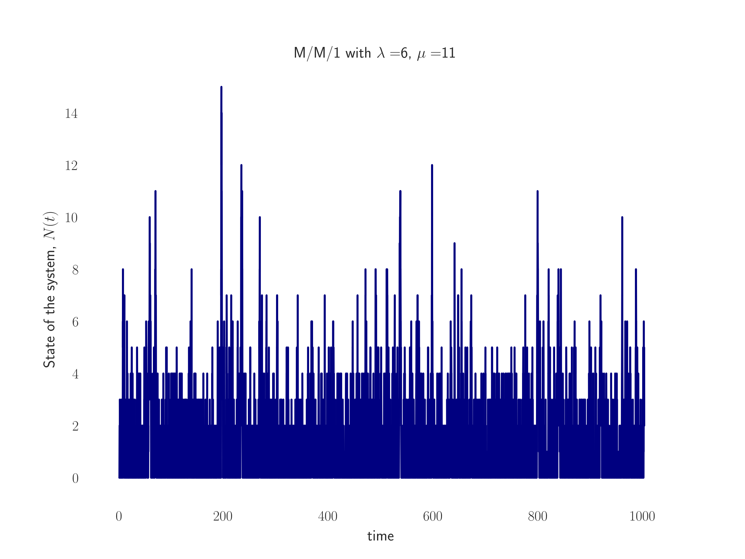
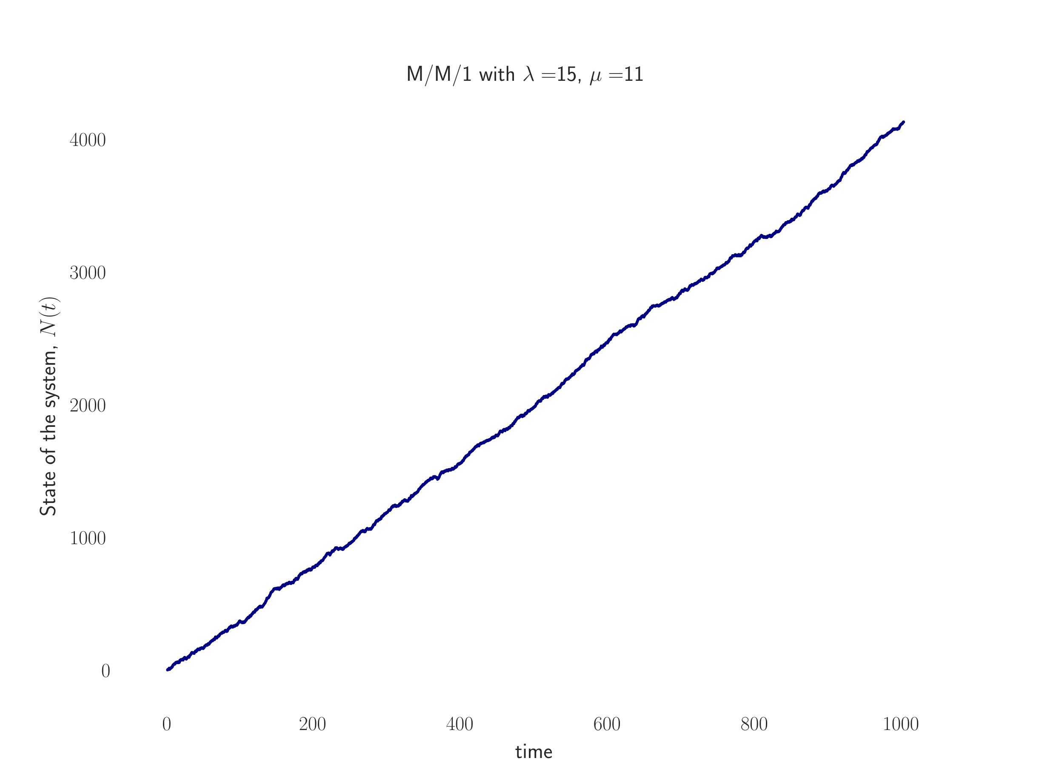
M / M / 1 - Simulations
Evolution of the state with time

Slide 14
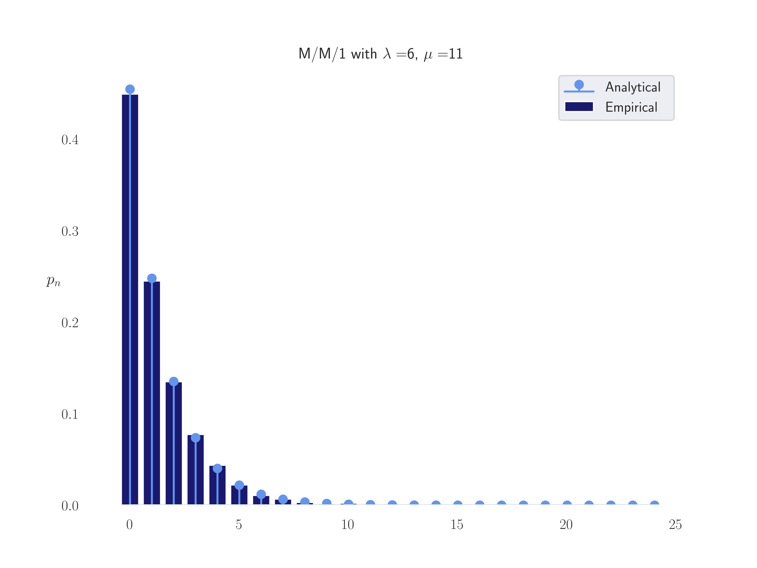
M / M / 1 - Simulations
Stationary State Distribution:

Slide 15
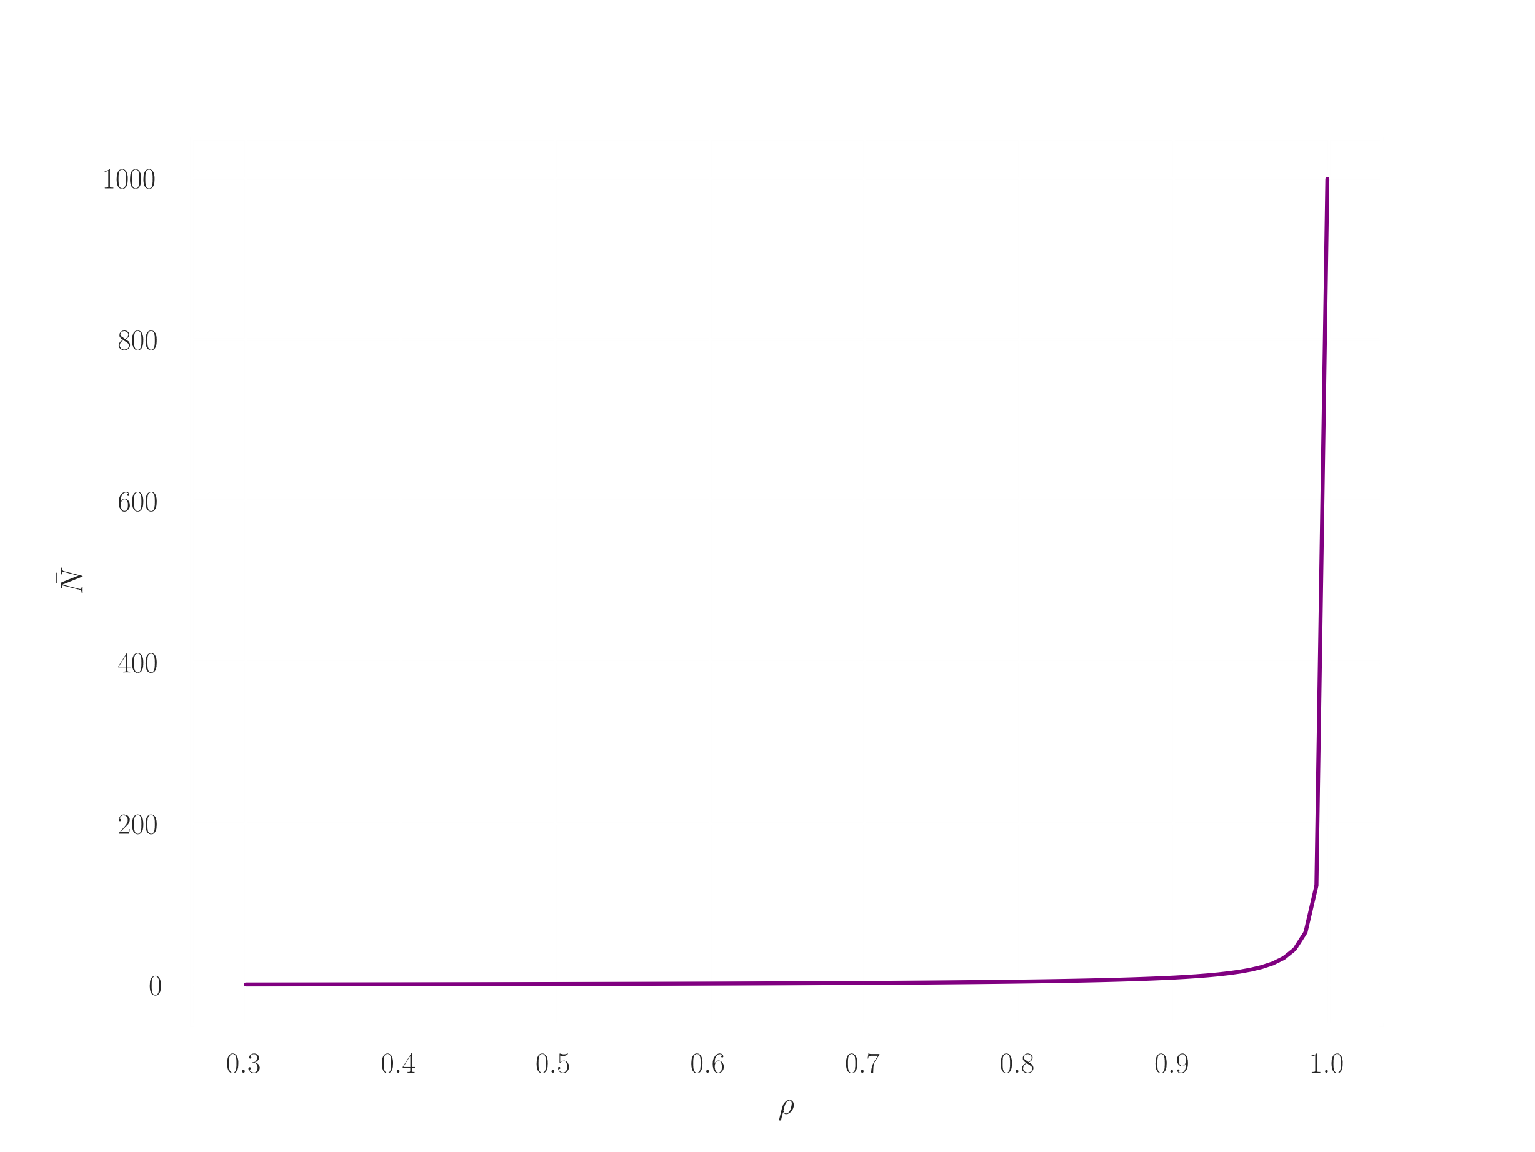
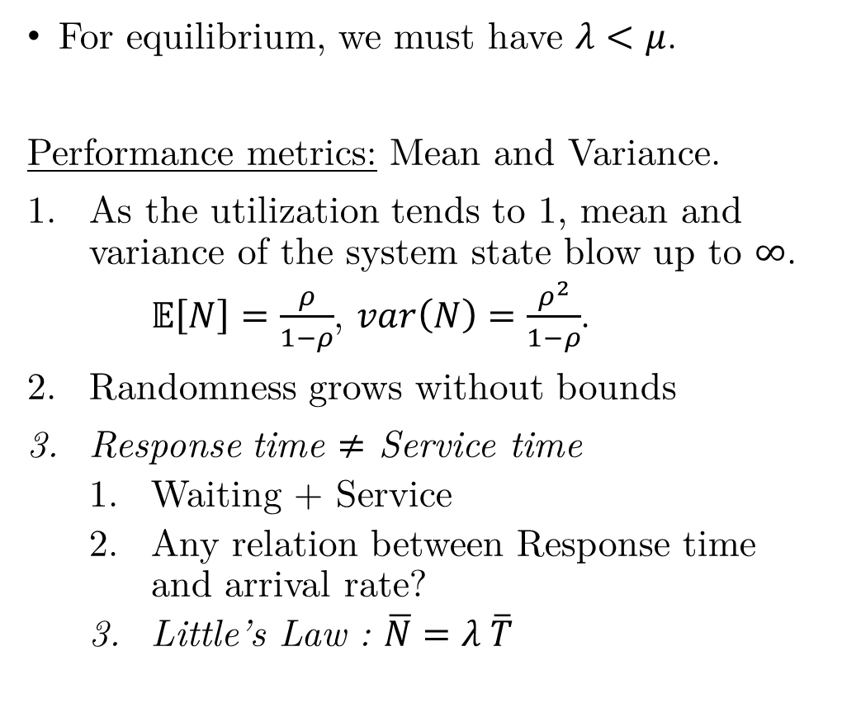
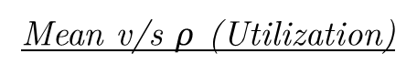
M / M / 1 - Insights
For equilibrium, we must have $λ<μ$.
Performance metrics: Mean and Variance.
As the utilization tends to 1, mean and variance of the system state blow up to $∞$.
$𝔼\left[N\right]=\frac{ρ}{1−ρ}$, $var\left(N\right)=\frac{ρ^{2}}{1−ρ}$.
Randomness grows without bounds
Response time $≠$ Service time
Waiting + Service
Any relation between Response time and arrival rate?
Little’s Law : $\overline{N}=λ \overline{T}$
Mean v/s $ρ$ (Utilization)

Slide 16
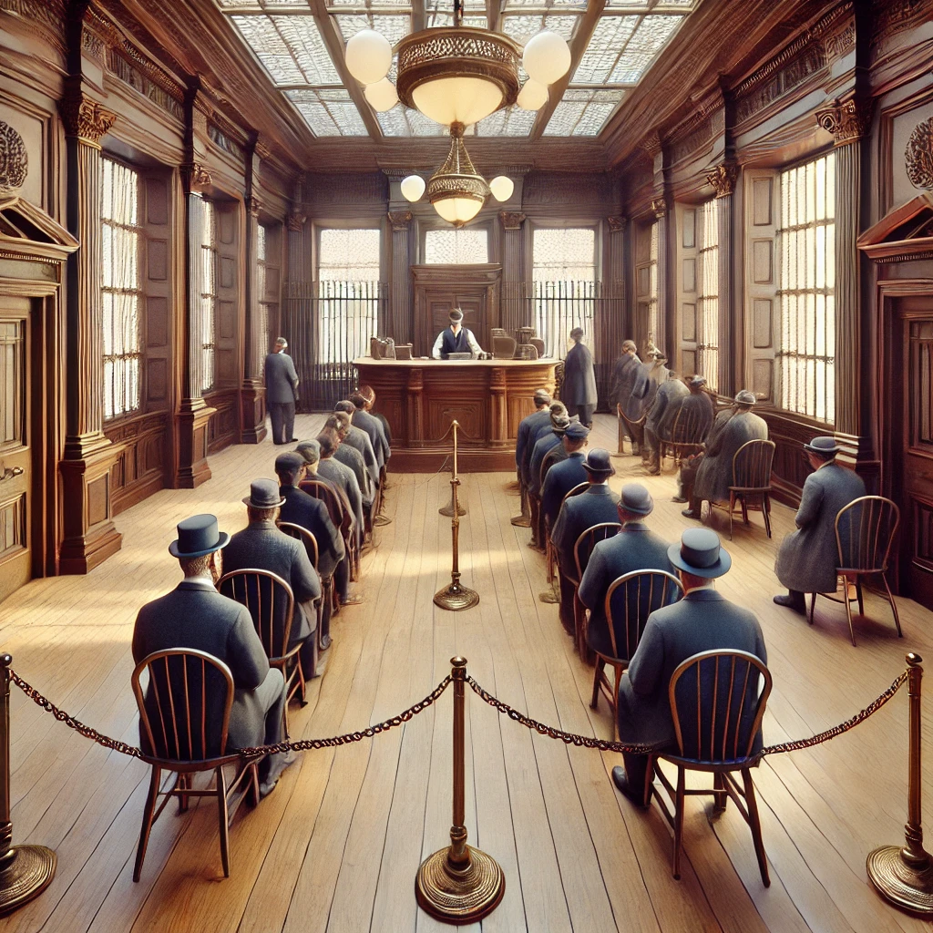
M / M / 1 / N – Finite buffer size
Why finite buffer size?
Finite capacity.
Example. An airport is unlikely to be able to accommodate infinite airplanes.
Model description:
(1) – (5) from M/M/1.
Finite buffer size of N.
Any excess/ additional arrivals
Turned down/ blocked/ dropped.
Do not return if blocked once.
Source: DALL·E

Slide 17
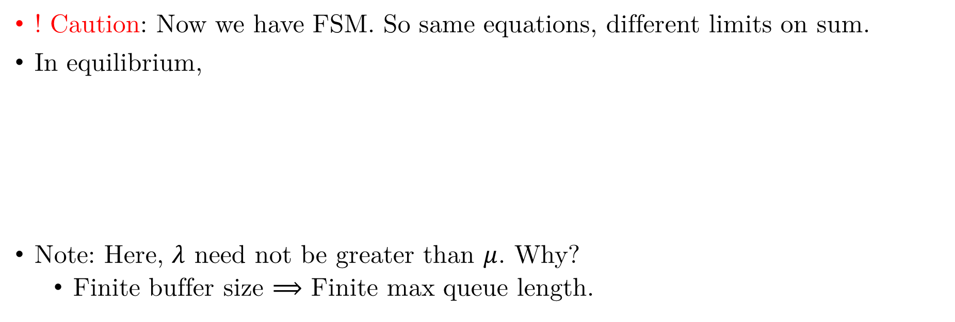
M / M / 1 / N - Summary
! Caution: Now we have FSM. So same equations, different limits on sum.
In equilibrium,
Note: Here, $λ$ need not be greater than $μ$. Why?
Finite buffer size $⟹$ Finite max queue length.

Slide 18
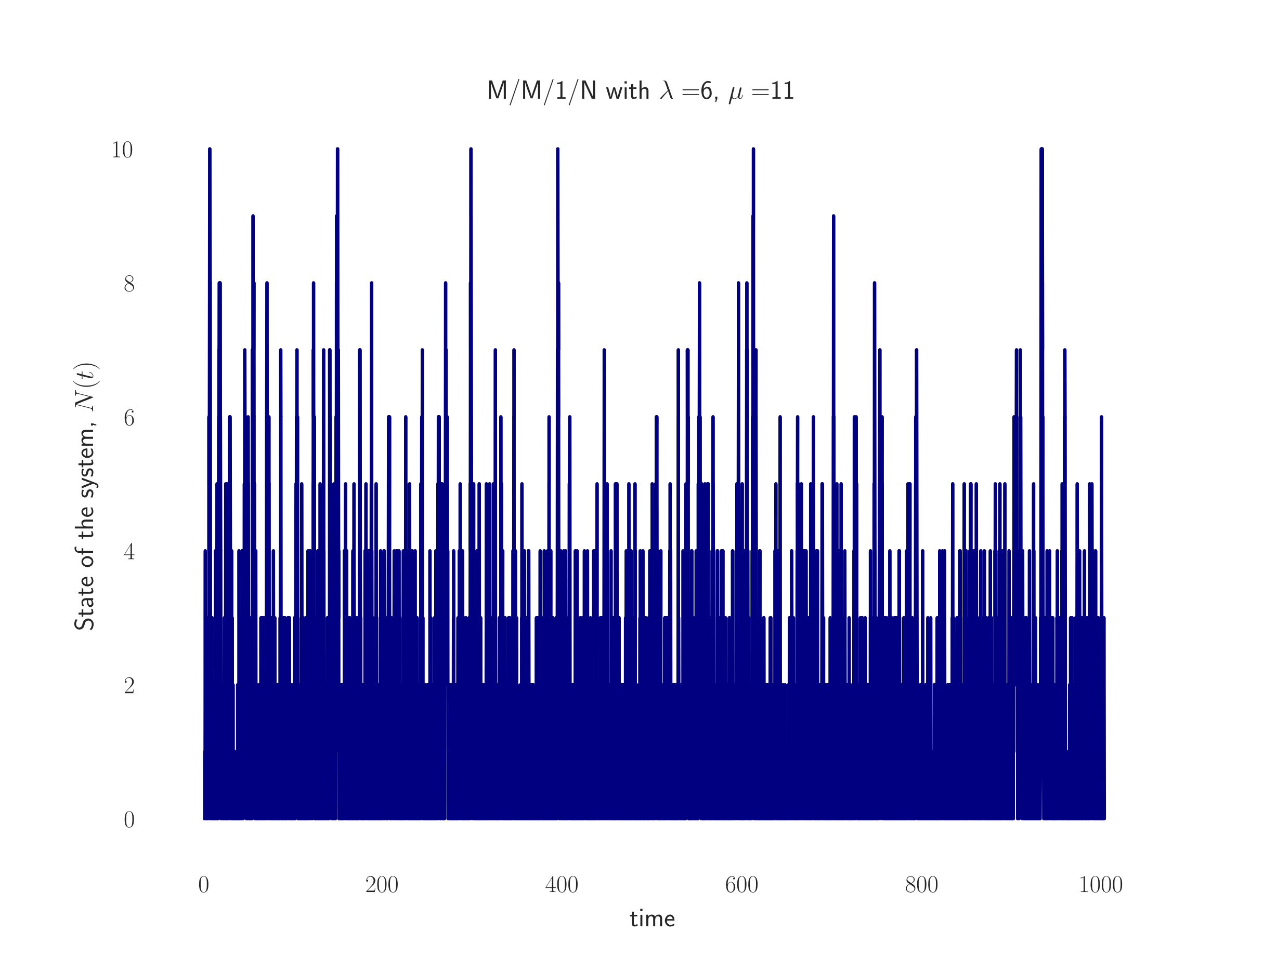
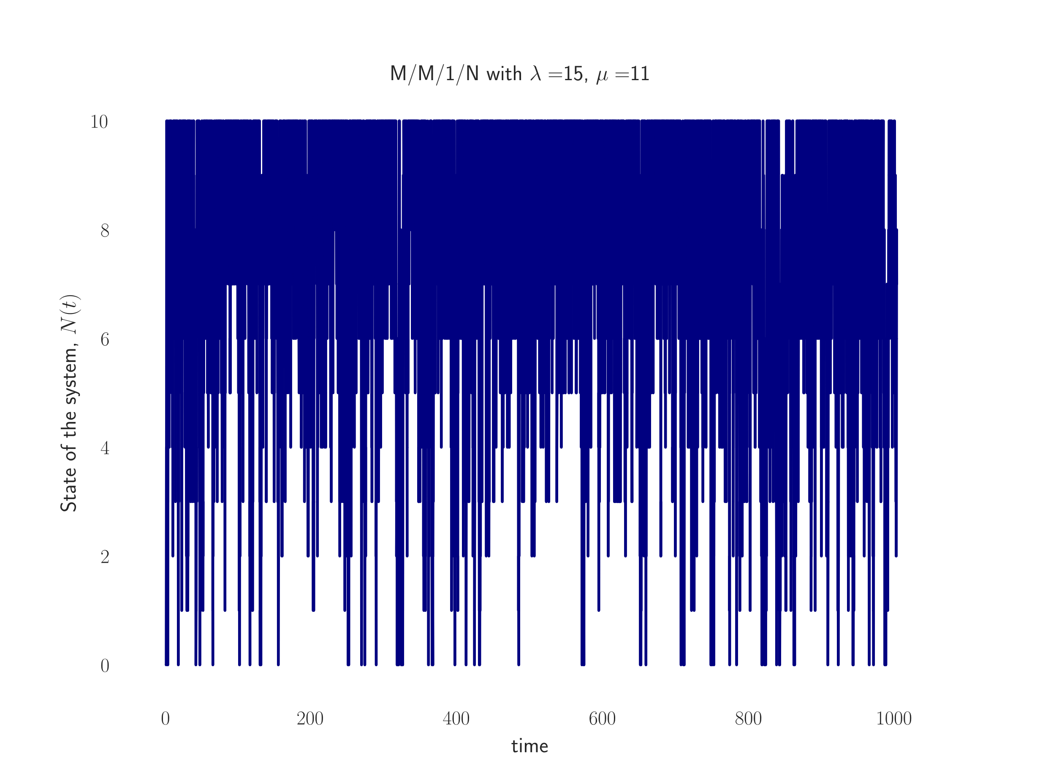
M / M / 1 / N - Simulations
Evolution of the queue with

Slide 19
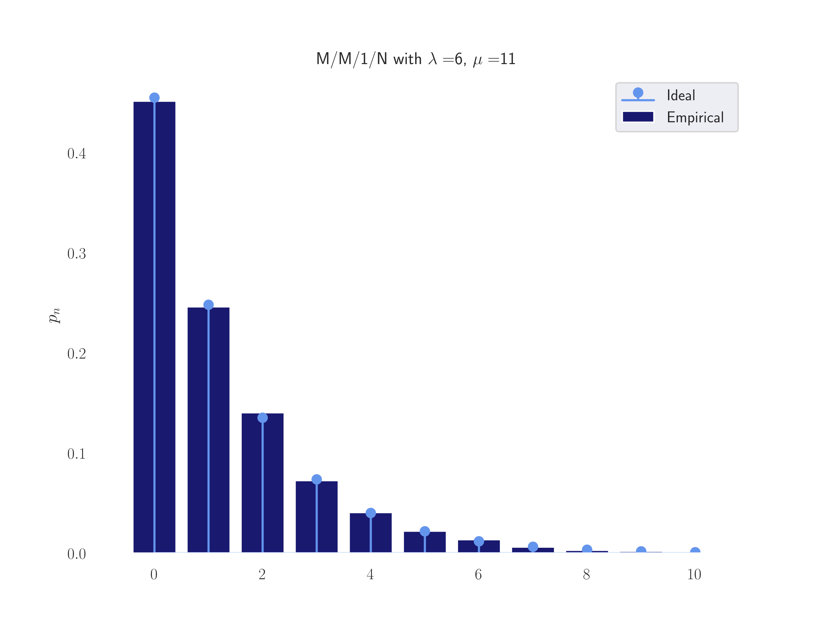
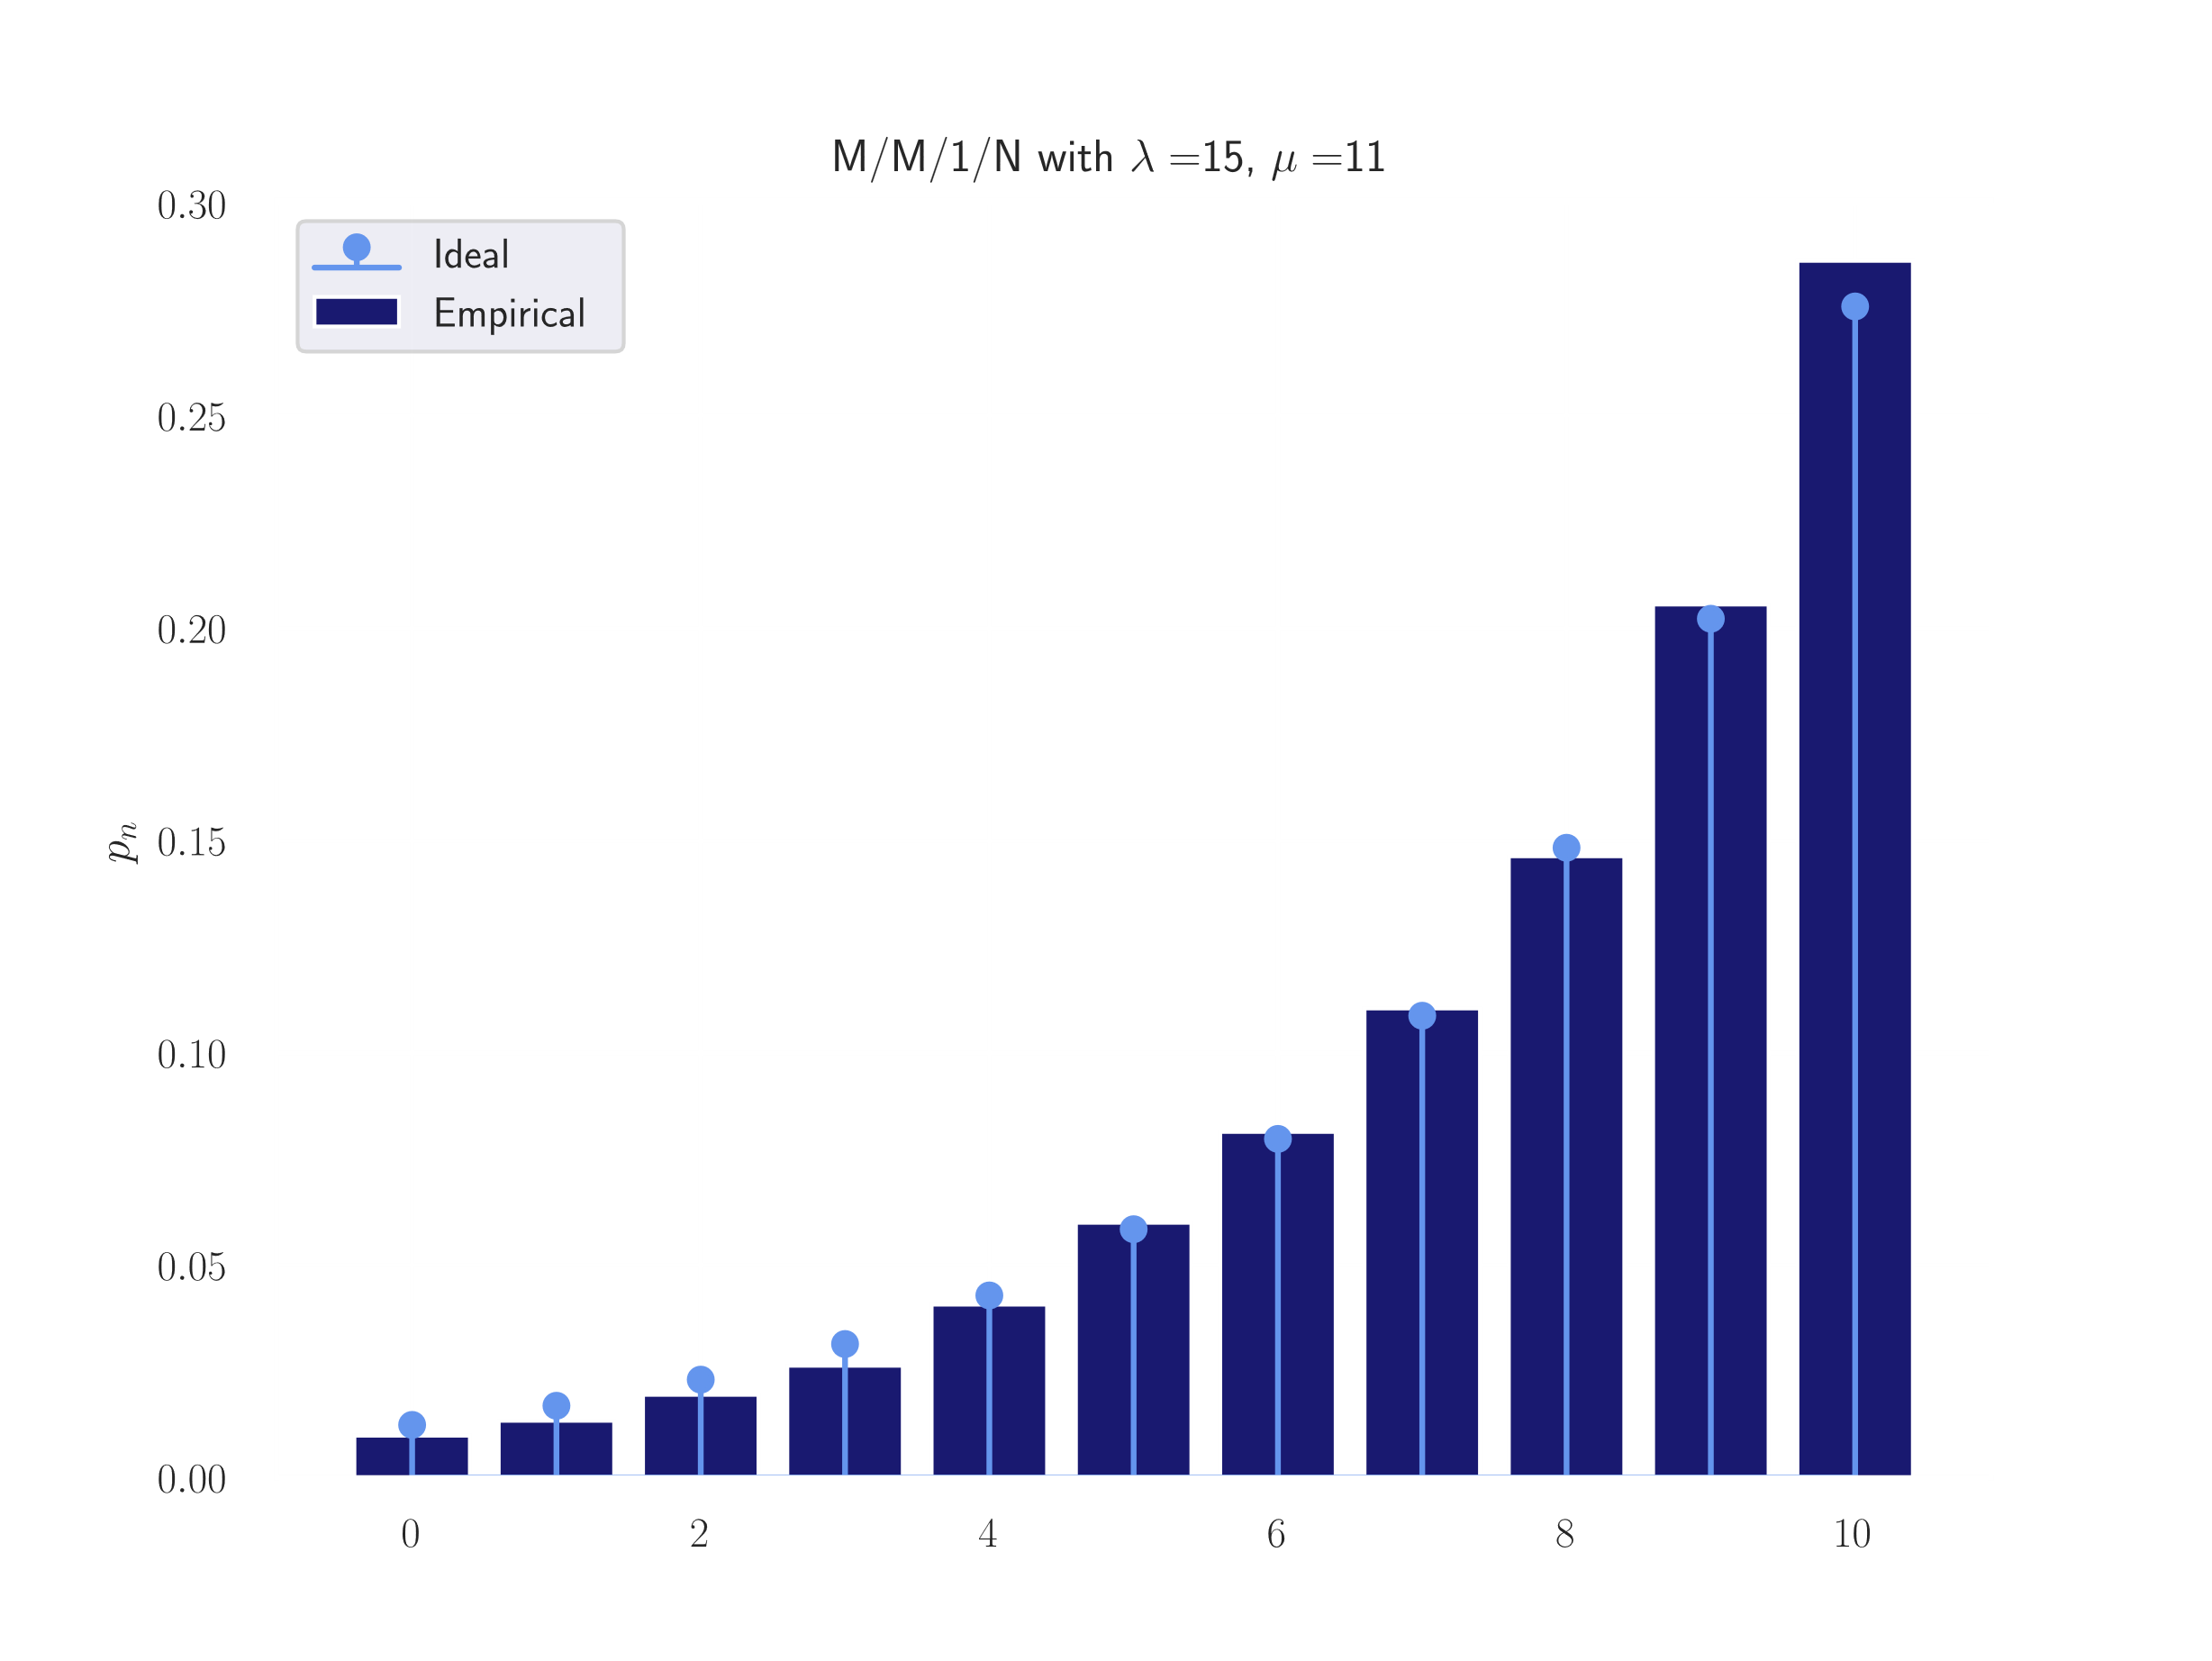
M / M / 1 / N – Simulations
Stationary State Distribution when

Slide 20
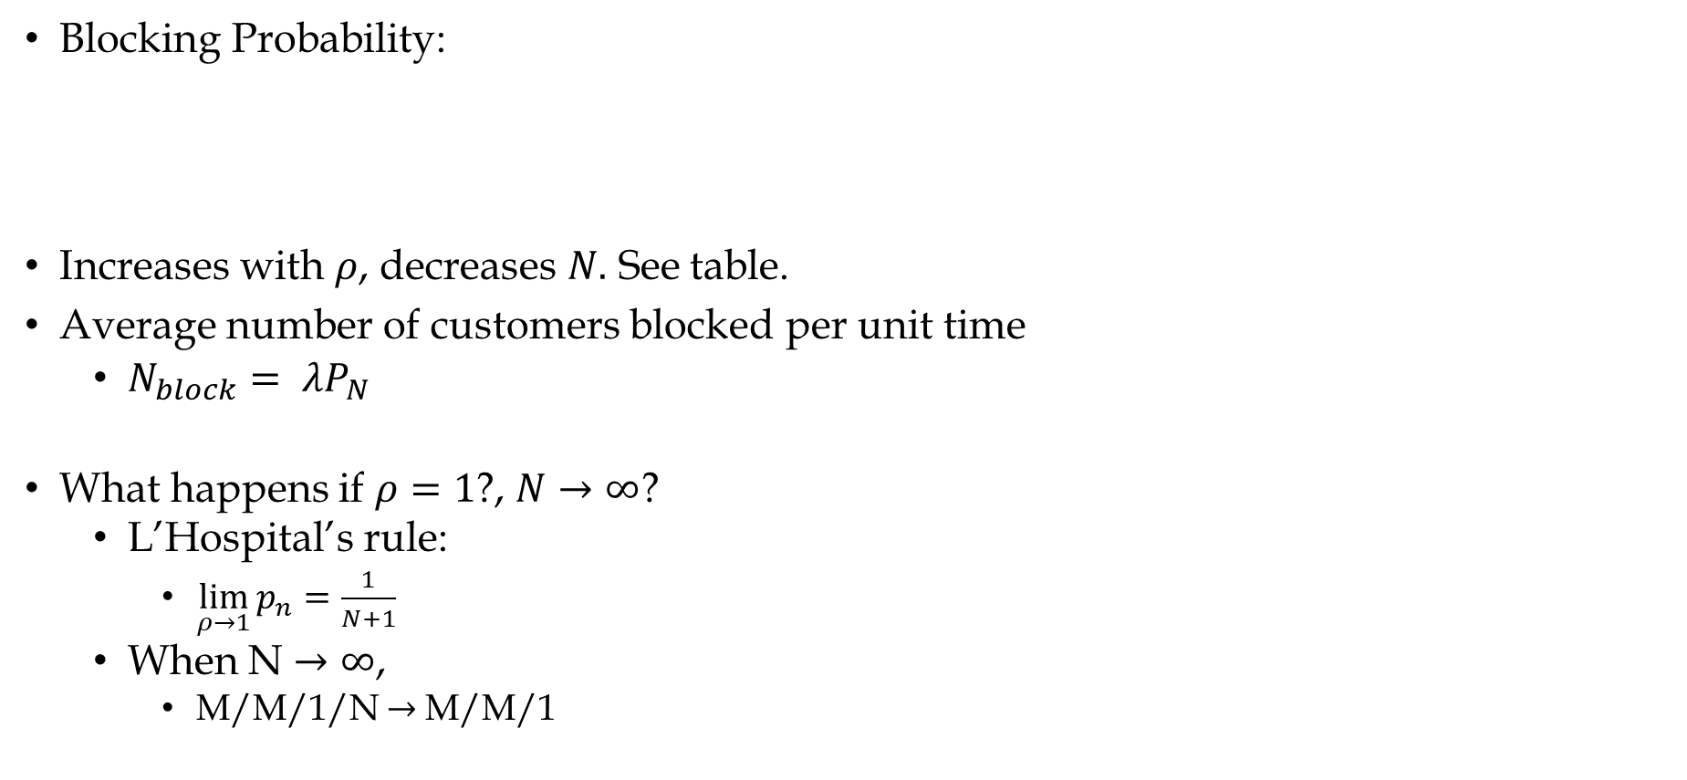
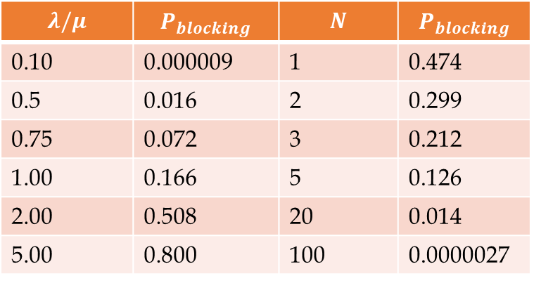
M / M / 1 / N - Insights
Blocking Probability:
Increases with $ρ$, decreases $N.$ See table.
Average number of customers blocked per unit time
$N_{block}= λP_{N}$
What happens if $ρ=1$?, $N→∞$?
L’Hospital’s rule:
$\lim_{ρ→1}{p_{n}}=\frac{1}{N+1}$
When N $→∞$,
M/M/1/N $→$M/M/1
$$λ/μ$$ | $$P_{blocking}$$ | $$N$$ | $$P_{blocking}$$
0.10 | 0.000009 | 1 | 0.474
0.5 | 0.016 | 2 | 0.299
0.75 | 0.072 | 3 | 0.212
1.00 | 0.166 | 5 | 0.126
2.00 | 0.508 | 20 | 0.014
5.00 | 0.800 | 100 | 0.0000027
Source: [2]

Slide 21
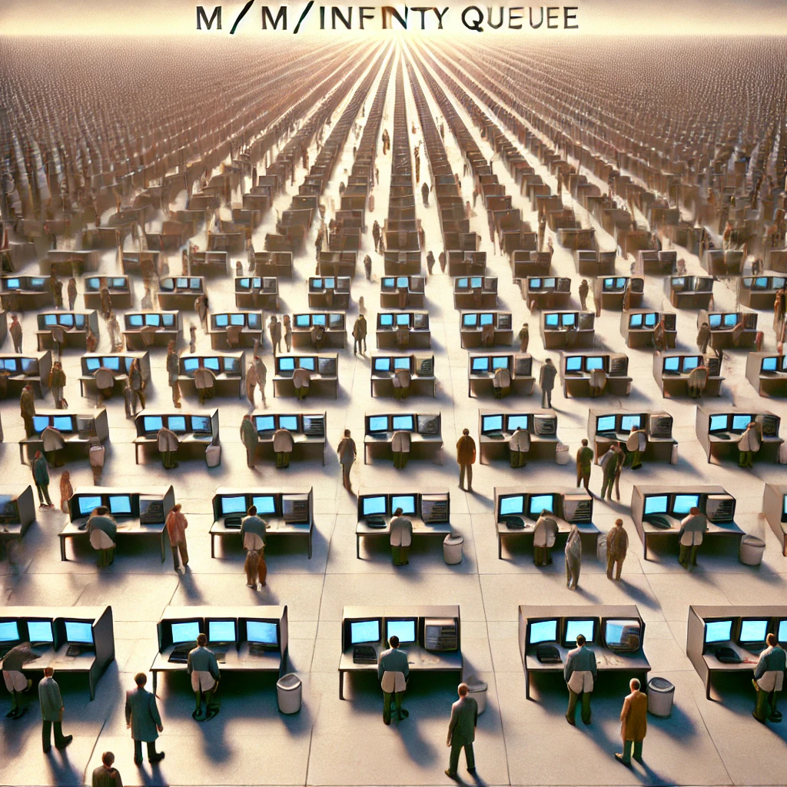

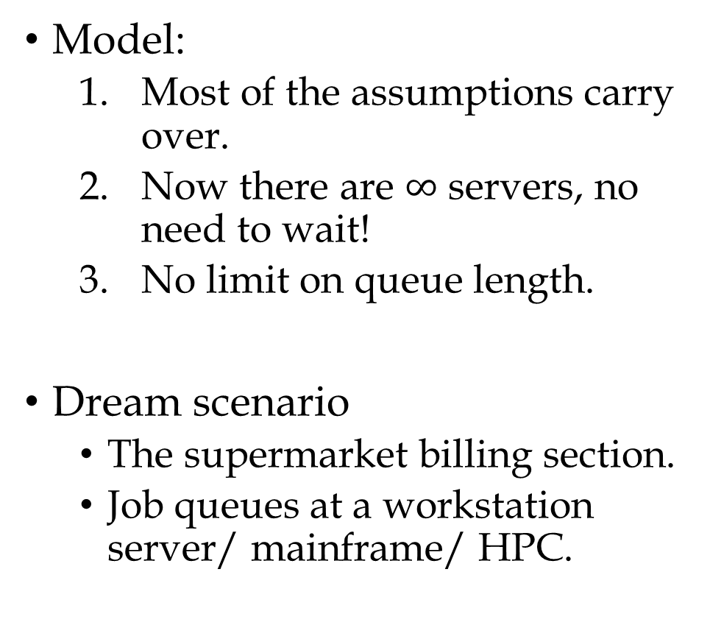
M / M / $∞$ - Infinite servers
Model:
Most of the assumptions carry over.
Now there are $∞$ servers, no need to wait!
No limit on queue length.
Dream scenario
The supermarket billing section.
Job queues at a workstation server/ mainframe/ HPC.
Source: DALL·E
Notes:
Now we will exploit a different degree of freedom. That is the number of servers in a queue. With people banking on parallelism for efficiency gains, these kinds of queues are of paramount importance. All the servers, workstations, mainframes depend on multiple processors.
Besides, even in human queues it is unlikely that a bank or even a branch of it has only one employee to serve all customers. Thus, this model is very important.
We first begin with a dream scenario where there is a server for every customer. So there is now no need to wait. Any arriving customer will directly go into service. Additionally, we will relax the finite queue size limit that was imposed in the previous model.

Slide 22
M / M /$∞$ - Summary
In equilibrium,

Slide 23
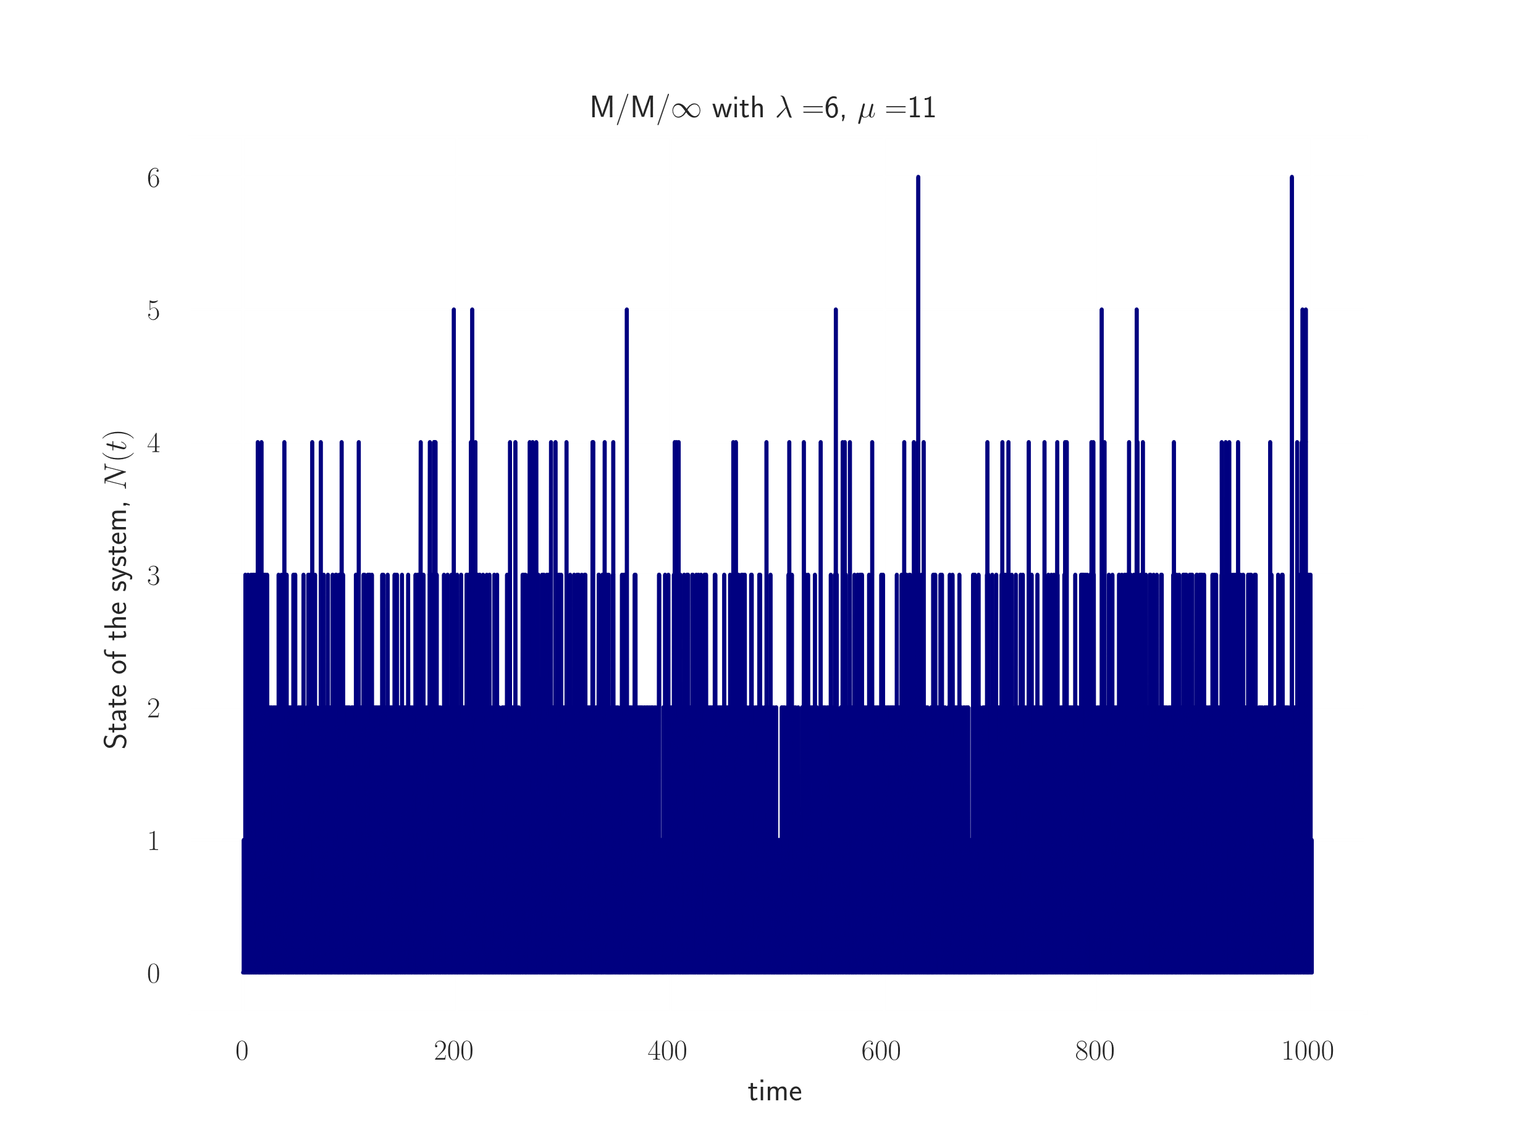
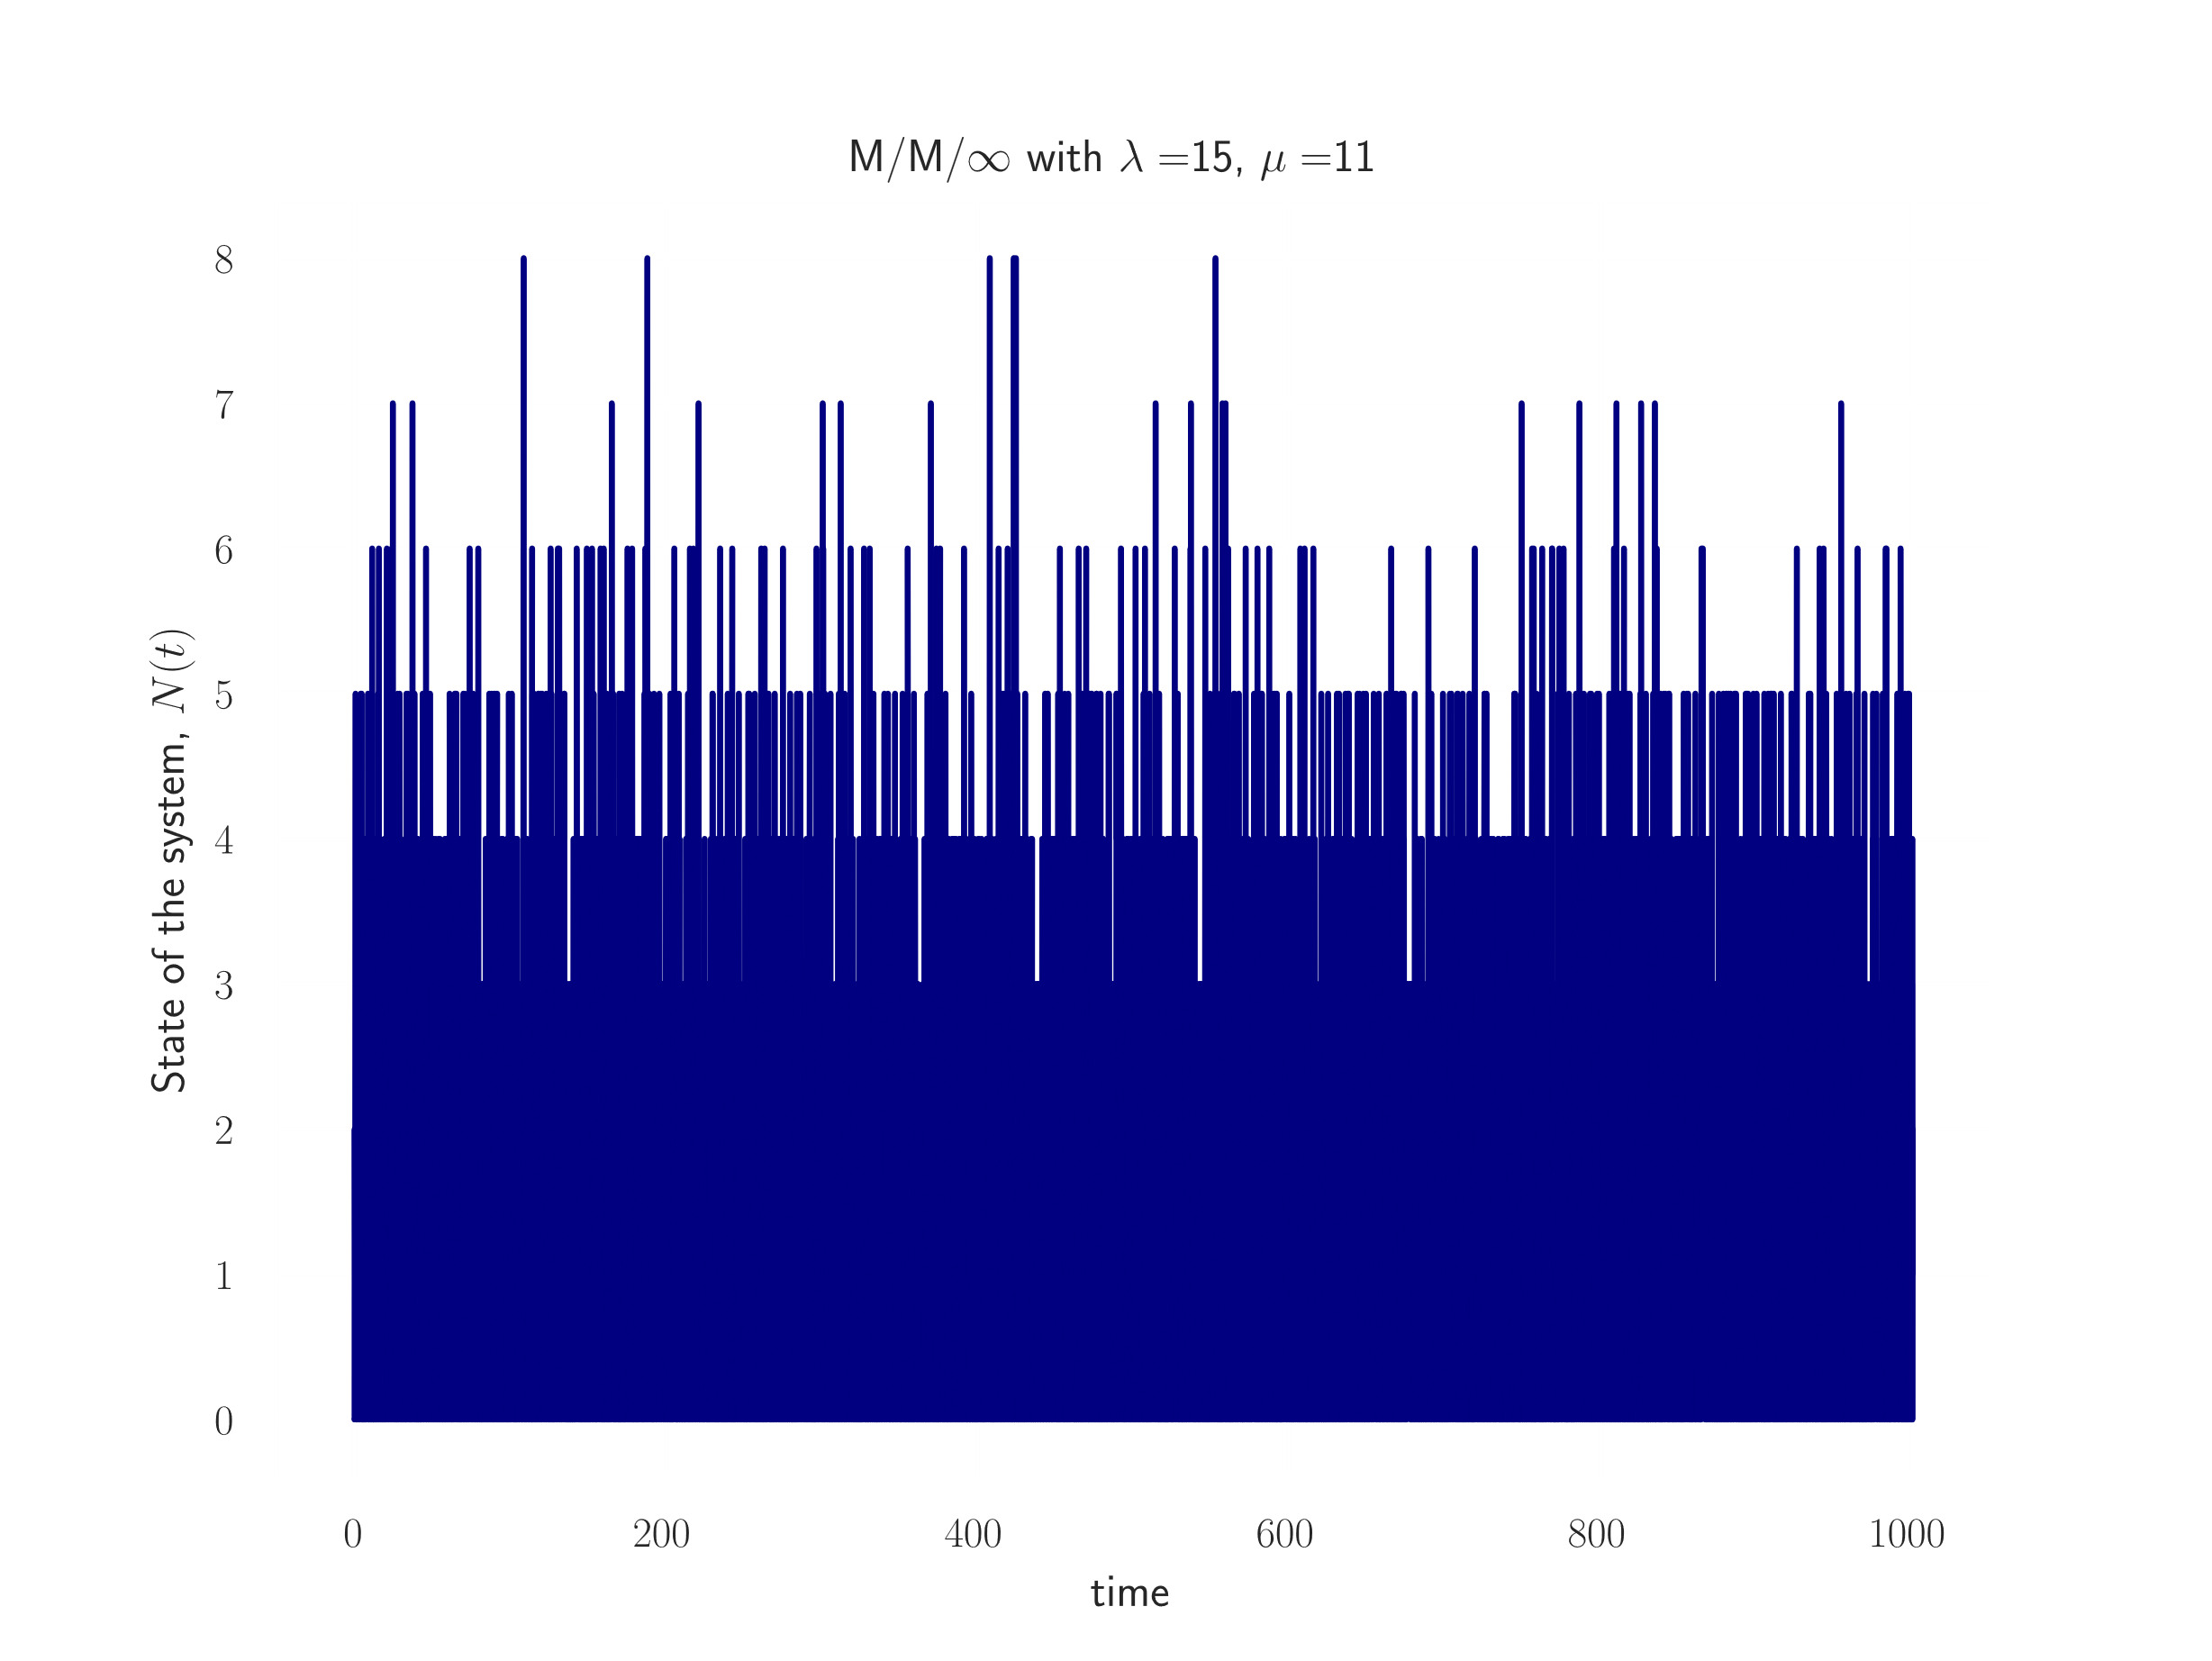
M / M /$∞$ - Simulations
Evolution of state with

Slide 24
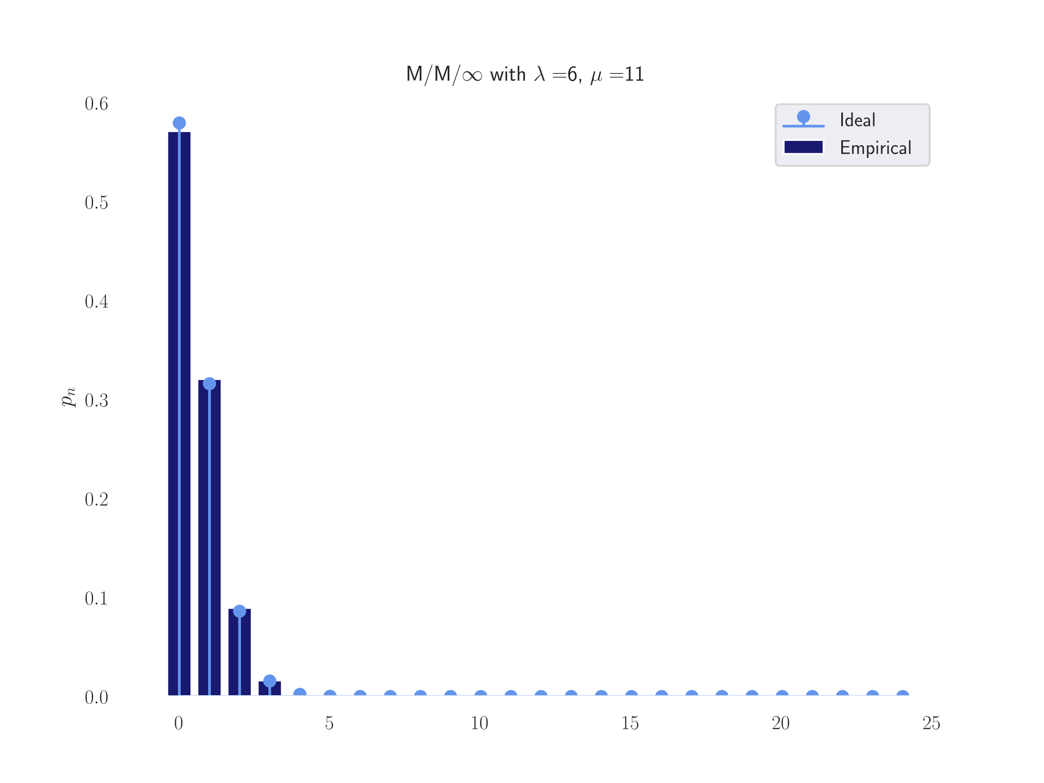
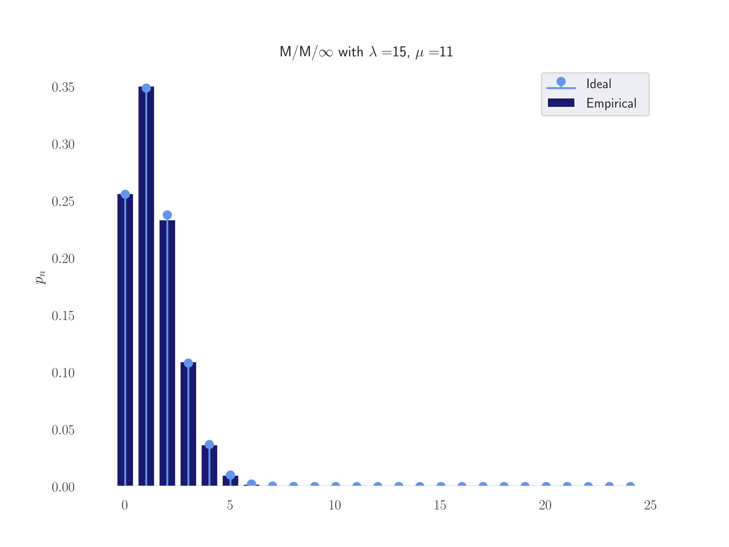
M / M /$∞$ - Simulations
Stationary State Distributions with

Slide 25
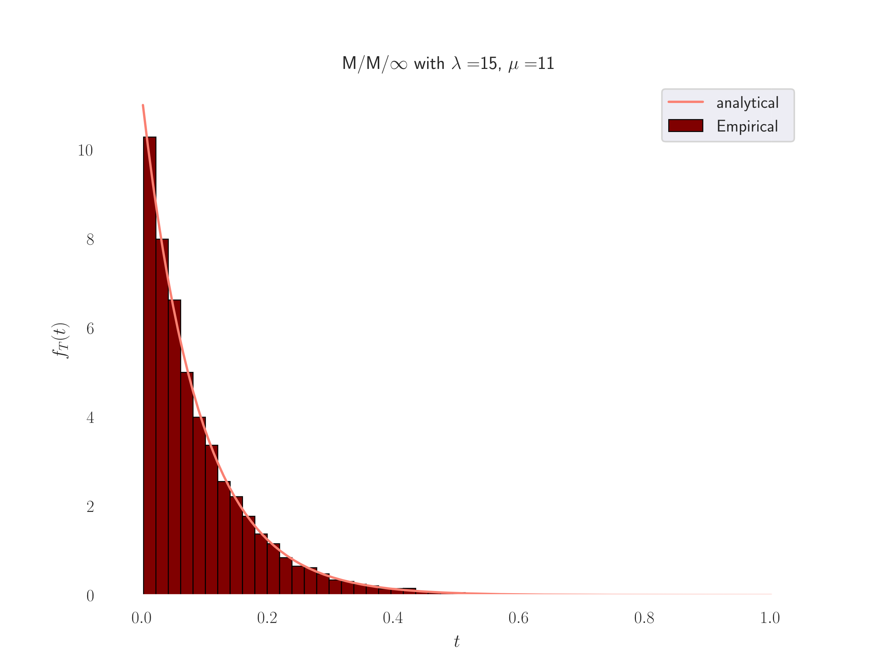
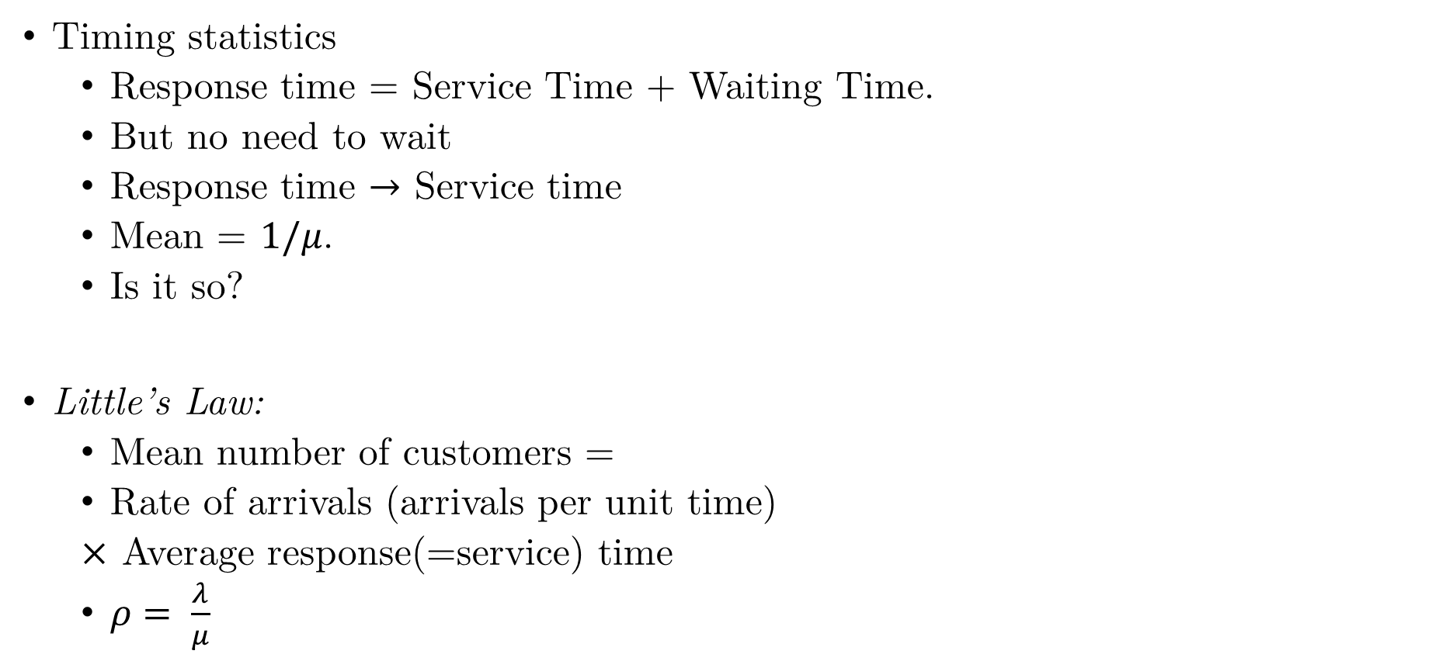
M / M / $∞$ - Simulations
Timing statistics
Response time = Service Time + Waiting Time.
But no need to wait
Response time $→$ Service time
Mean = $1/μ$.
Is it so?
Little’s Law:
Mean number of customers =
Rate of arrivals (arrivals per unit time)
$×$ Average response(=service) time
$ρ= \frac{λ}{μ}$

Slide 26
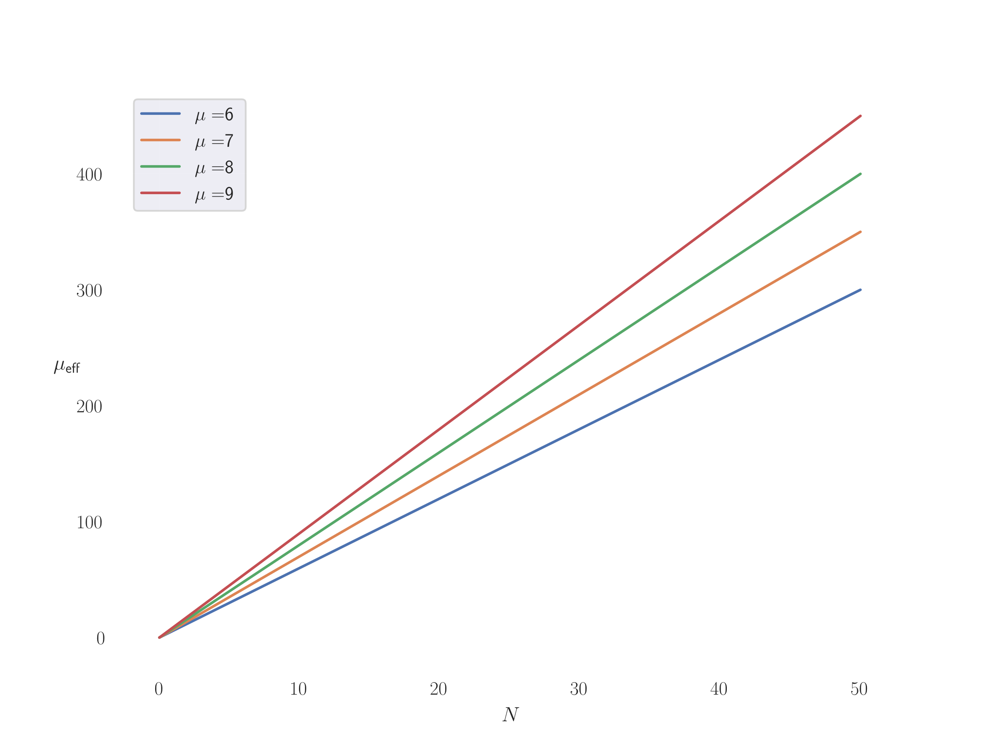
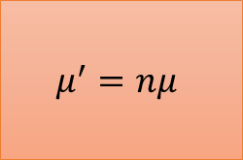
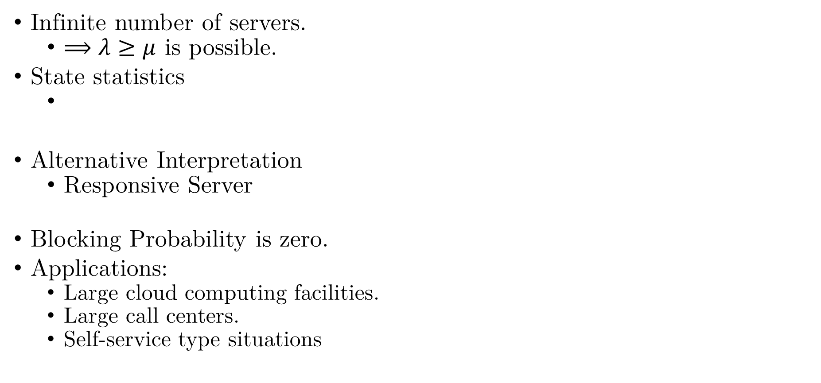
M / M / $∞$ - Insights
Infinite number of servers.
$⟹λ≥μ$ is possible.
State statistics
Alternative Interpretation
Responsive Server
Blocking Probability is zero.
Applications:
Large cloud computing facilities.
Large call centers.
Self-service type situations
$$μ^{′}=nμ$$
Responsive Server

Slide 27

M / M / m – Multi-servers (finite)
Model:
Same statistics for arrivals and departures.
But fall back into reality.
Finite servers
Queue size has no limits.
More realistic assumptions than previous model(s).
Source: DALL·E

Slide 28
M / M / m – Summary
In equilibrium,
where,

Slide 29
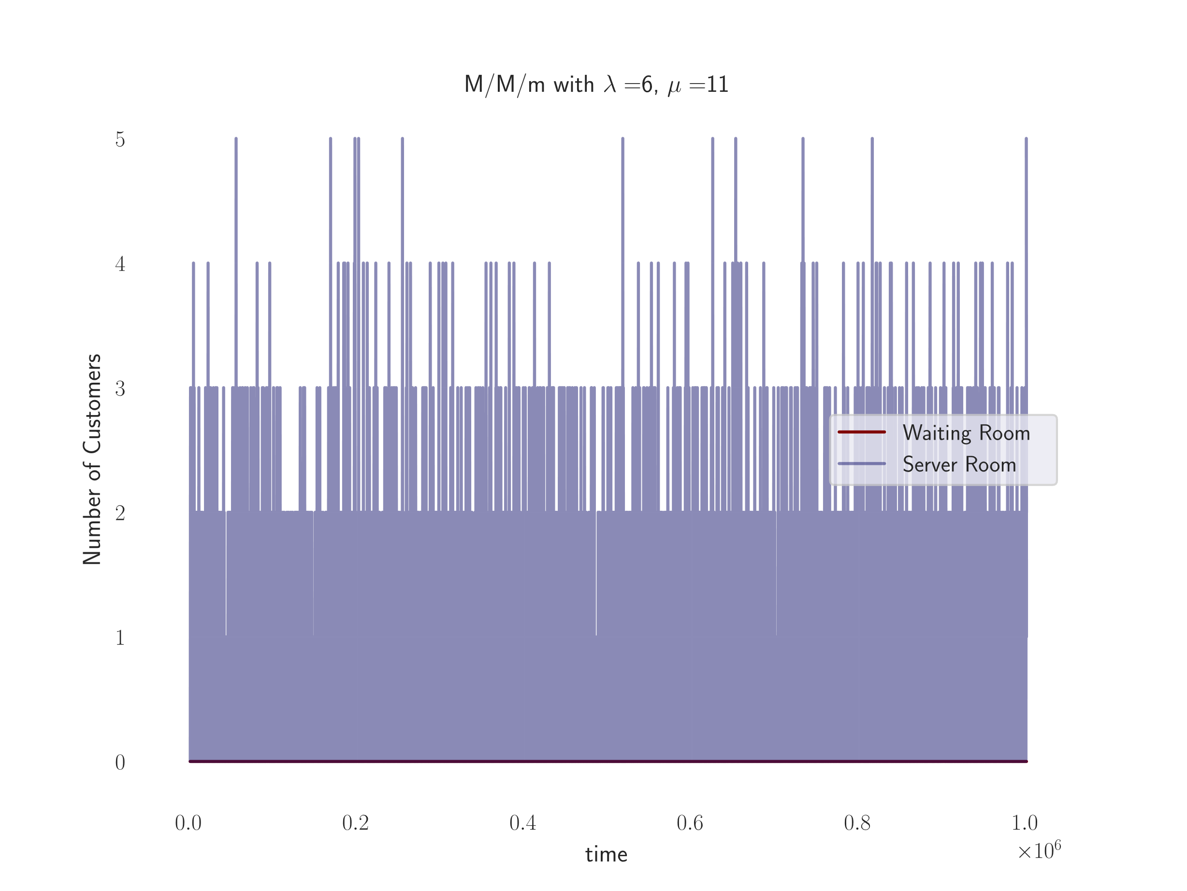
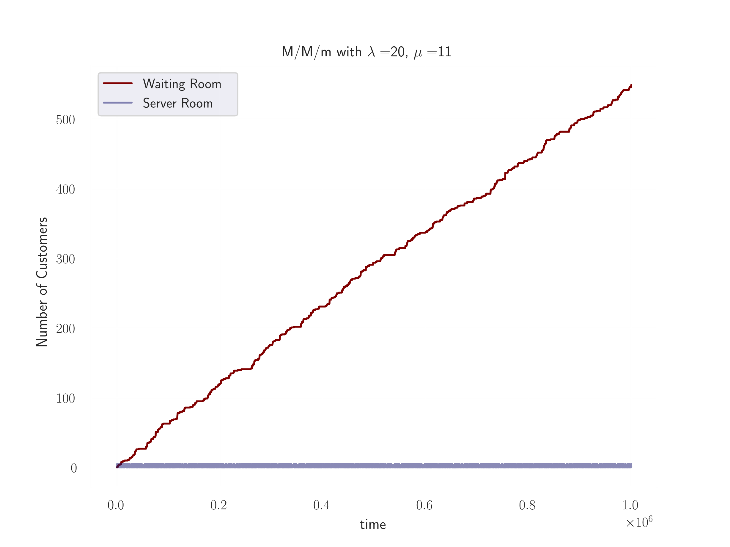
M / M / m - Simulations
Let’s see some other plots
Visualize the state of the ‘waiting room’ and ‘server room’
m = 5.

Slide 30
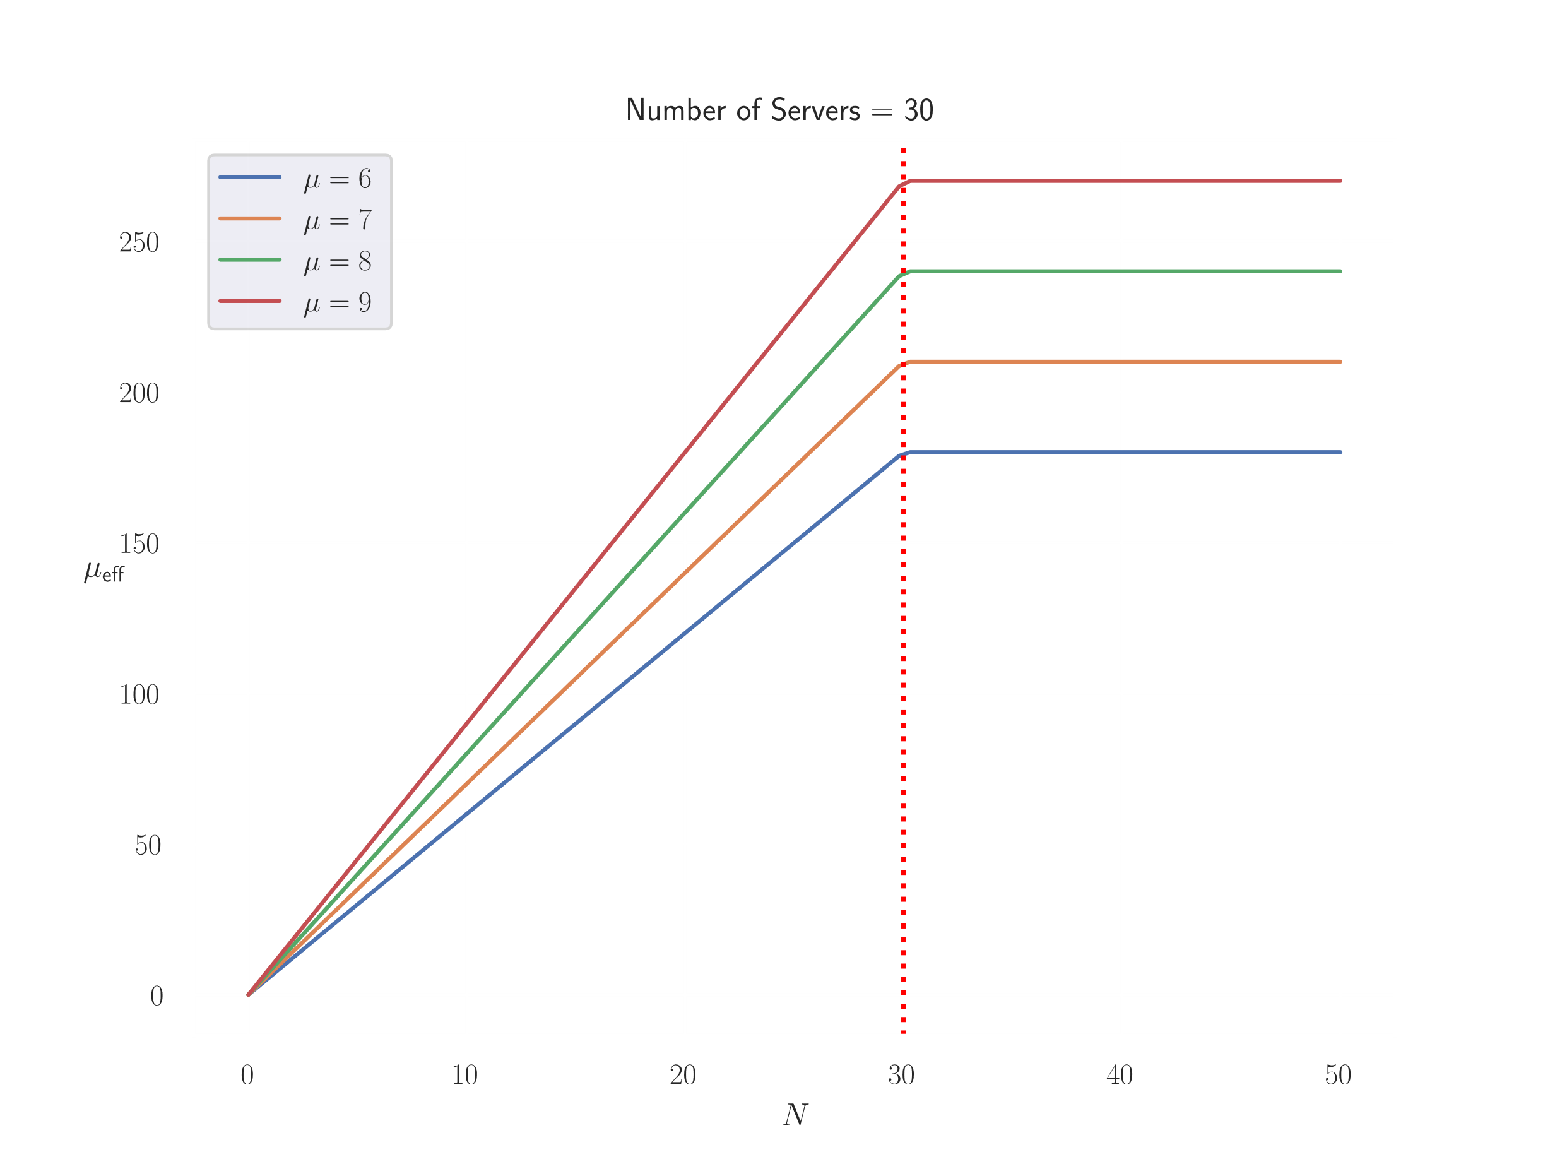
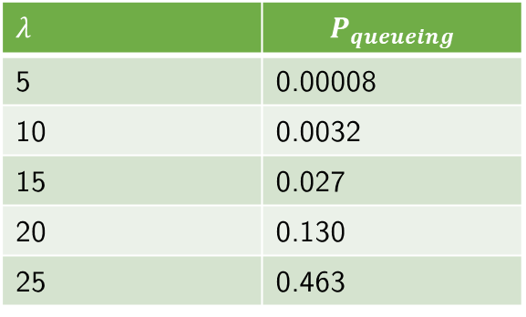
M / M / m - Insights
This and previous model
Load-dependent servers
N = number of customers
Queueing Probability
Erlang – C formula
Widely used in telecommunication
$λ$ | $$P_{queueing}$$
5 | 0.00008
10 | 0.0032
15 | 0.027
20 | 0.130
25 | 0.463

Slide 31
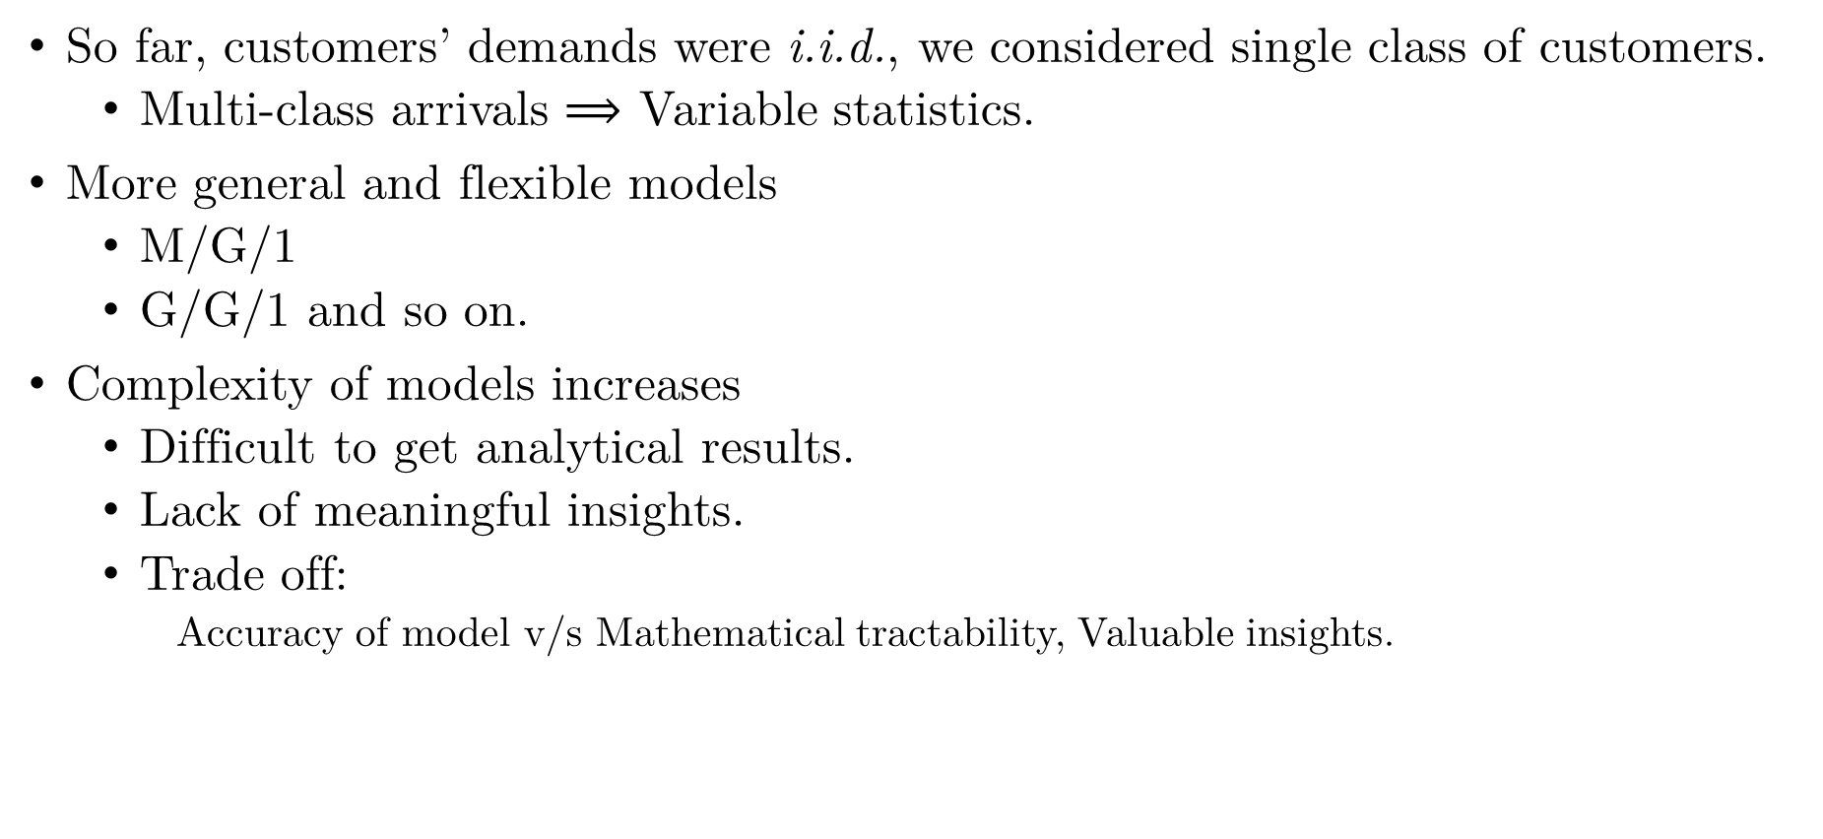
Other models
So far, customers’ demands were i.i.d., we considered single class of customers.
Multi-class arrivals $⟹$ Variable statistics.
More general and flexible models
M/G/1
G/G/1 and so on.
Complexity of models increases
Difficult to get analytical results.
Lack of meaningful insights.
Trade off:
Accuracy of model v/s Mathematical tractability, Valuable insights.

Slide 32
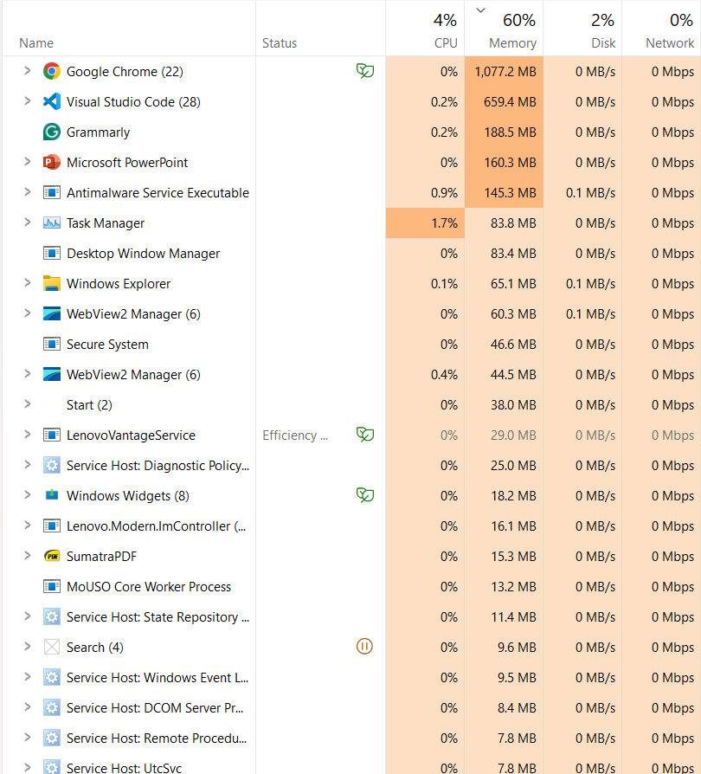
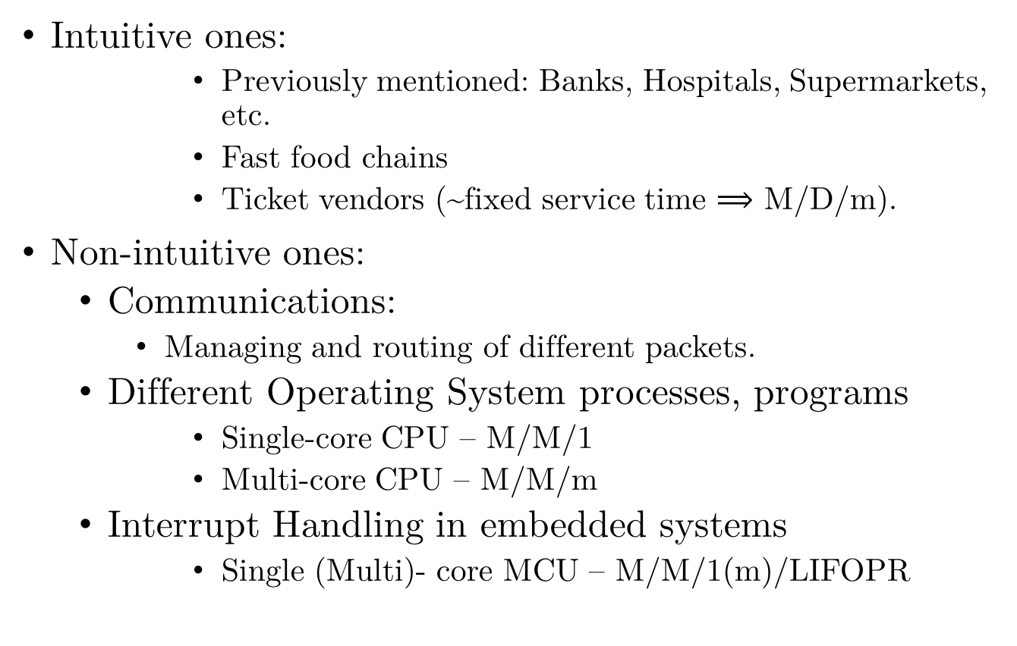
Applications
Intuitive ones:
Previously mentioned: Banks, Hospitals, Supermarkets, etc.
Fast food chains
Ticket vendors (~fixed service time $⟹$ M/D/m).
Non-intuitive ones:
Communications:
Managing and routing of different packets.
Different Operating System processes, programs
Single-core CPU – M/M/1
Multi-core CPU – M/M/m
Interrupt Handling in embedded systems
Single (Multi)- core MCU – M/M/1(m)/LIFOPR

Slide 33
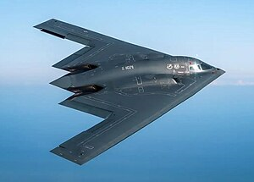
Critical Application – A case study
US Military – Scheduling B-2 Bomber maintenance
Limited Resource – Only 20 of B2s.
Required at a moment’s notice.
FHP, Wartime posture
Frequent maintenance period of 18–45 days!
Issue: Unpredictable scheduling, downtime.
Due to asymmetric usage
Result:
Decreased aircraft availability (AA).
~4.75 in heavy maintenance, ~3 in light maintenance.
AA = ~60% of total capacity
Unacceptable.
Northrop B-2 Spirit
Source: https://en.wikipedia.org/wiki/Northrop_B-2_Spirit#/media/File:B-2_Spirits_on_Deployment_to_Indo-Asia-Pacific.jpg

Slide 34
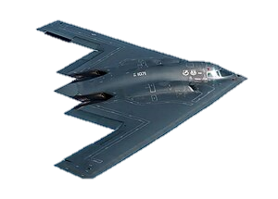
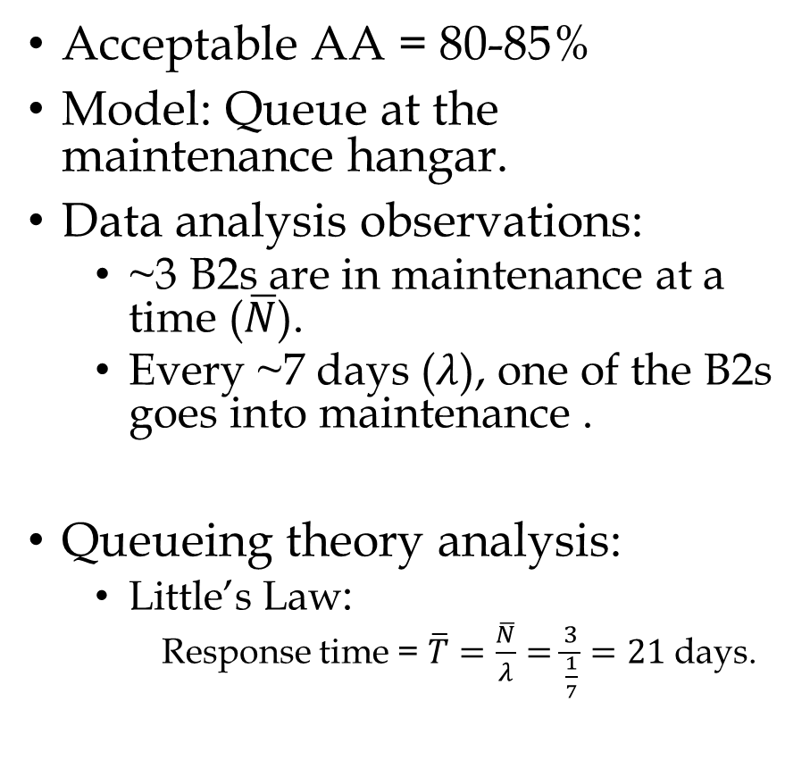
Critical Application – A case study
Acceptable AA = 80-85%
Model: Queue at the maintenance hangar.
Data analysis observations:
~3 B2s are in maintenance at a time ($\overline{N}$).
Every ~7 days ($λ$), one of the B2s goes into maintenance .
Queueing theory analysis:
Little’s Law:
Response time = $\overline{T}=\frac{\overline{N}}{λ}=\frac{3}{\frac{1}{7}}=21$ days.
Arrival
Departure
Work-In-Progress
Conclusion
The heavy LO maintenance routine must have a lead time of ~21 days to maintain acceptable AA.

Slide 35
References
H. Pishro-Nik. Introduction to Probability, Statistics, and Random Processes. Kappa Research,LLC, 2014.
Thomas G. Robertazzi. Computer Networks and Systems: Queueing Theory and Performance Evaluation. Springer-Verlag, Berlin, Heidelberg, 3rd edition, 2000.
William J. Stewart. Probability, Markov Chains, Queues, and Simulation: The Mathematical Basis of Performance Modeling. Princeton University Press, 2009.
https://www.isixsigma.com/case-studies/u-s-a-f-uses-continuous-process-improvement-on-the-b-2-bomber-part-1/

Slide 36
Thank You
Rishabh Pomaje
&
Samyak Sanjay Parakh

